Slide 1
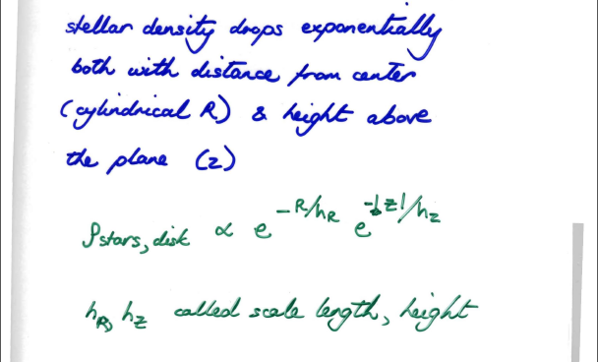
Milky Way thin disk

Slide 2
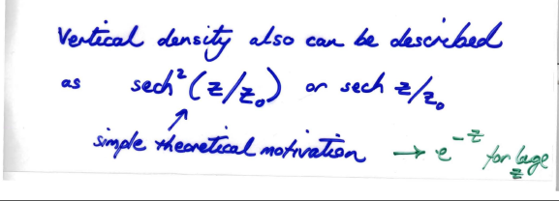
Q: in order to study the spatial distribution of the thin disk (which dominates the Milky Way luminosity) surface photometry in the K band from space has been used. What is the advantage of the K band? What sort of stars give off most of their light at 2 microns?

Slide 3
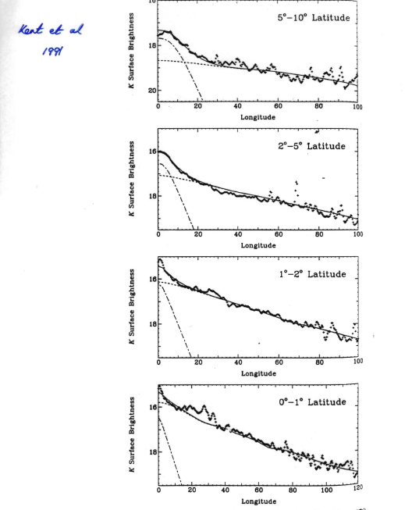
Q: these are Spacelab IR data, modeled with a bulge and exponential disk. What are the bumps and wiggles?

Slide 4
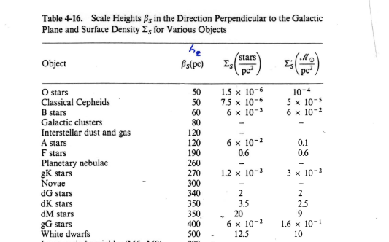
Mihalas and Binney Ch 4

Slide 5
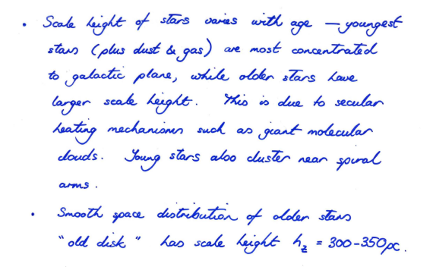
(from star count studies)

Slide 6
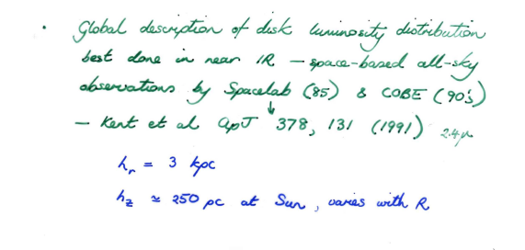

Slide 7
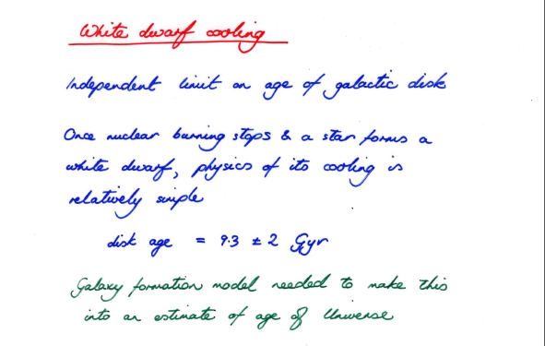
Age of thin disk

Slide 8
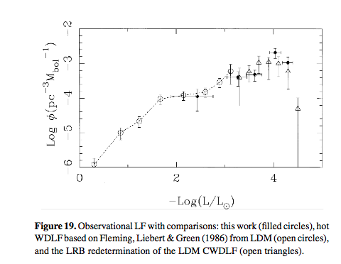
From Knox et al 1999

Slide 9
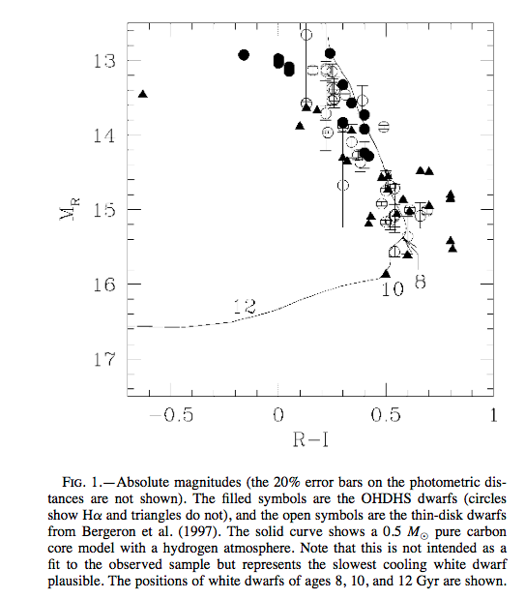
Hansen 2001

Slide 10
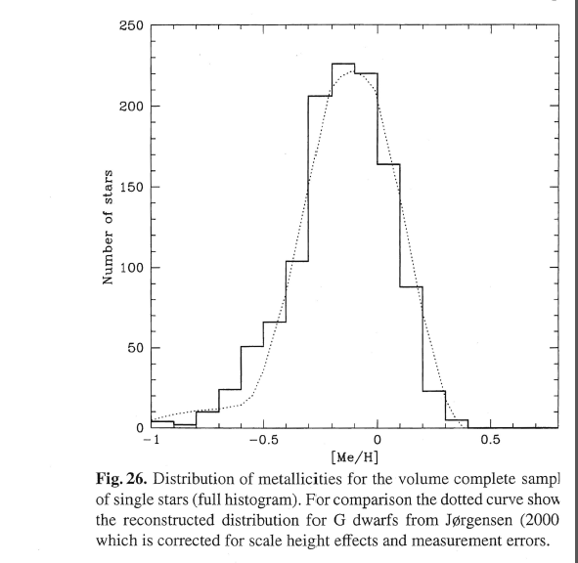
Thin disk metallicity distribution
The Sun is at the metal-rich end of the thin disk metallicity distribution
Nordstrom et al 2004

Slide 11
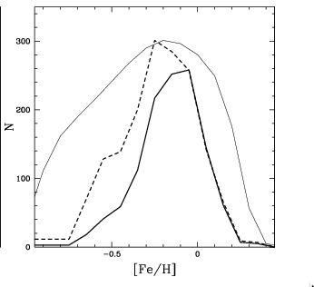
G dwarf problem
Heavy line is actual metallicity distribution; light solid line closed box model prediction
(Holmberg et al 2007)

Slide 12
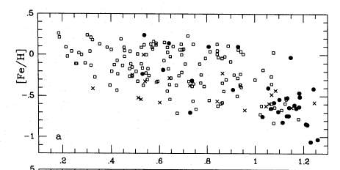
Metallicity vs age in the thin disk
Note large spread in age for a given [Fe/H]
(ages for individual stars are difficult and controversial) from Edvardsson et al 1993
Notes:
Different mean radii for different symbols

Slide 13
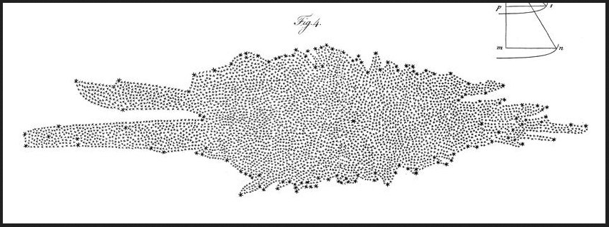
Mapping the Galaxy with star counts
The Herschels (1785) mapped the Galaxy with star counts, and got it quite wrong (why?)

Slide 14
Star count mapping
Q: what sort of assumptions would you need to make in order to work out the density distribution of the Galaxy using star counts?

Slide 15
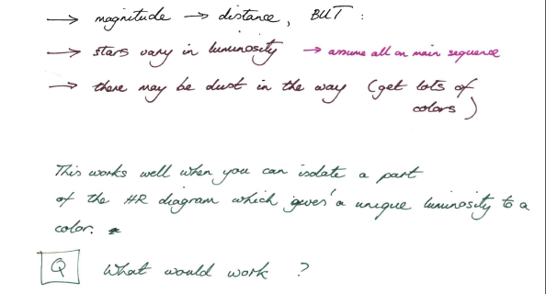
Star count mapping
Q: what sort of assumptions would you need to make in order to work out the density distribution of the Galaxy using star counts?
-> also metallicity affects luminosity

Slide 16
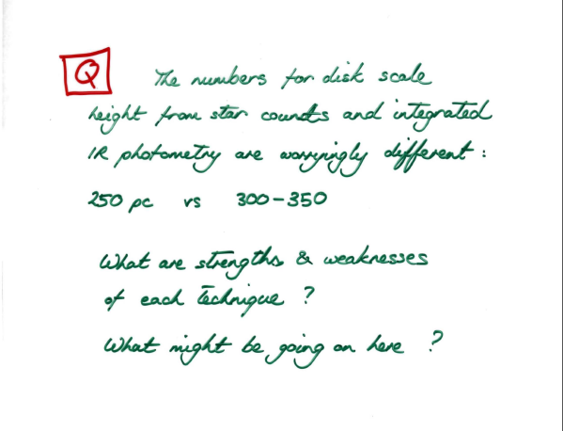
-> think of an effect that would go in the direction of making IR studies give a smaller scale height

Slide 17
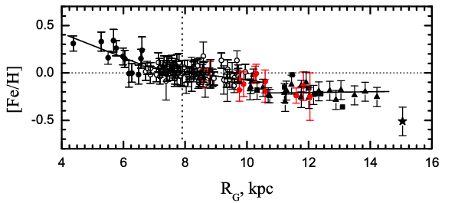
Metallicity gradient in the disk
Andrievsky, Luck et al (2004) – gradient from Cepheids

Slide 18
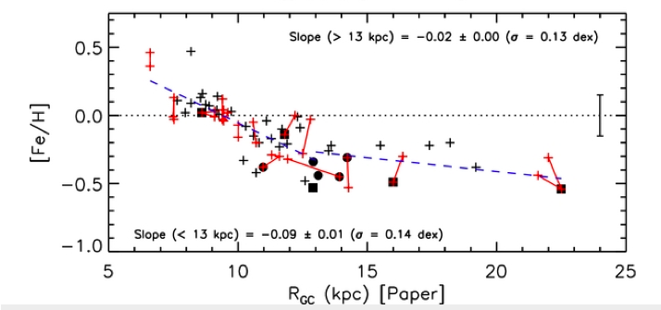
Open clusters (ages up to 10 Gyr)
Yong et al (2012)

Slide 19
Angular momentum redistribution by (transient) Spiral Arms:
Radius
Time
~ 20 kpc
(slide from Rok Roskar)
Notes:
Note the short timescales required for migration and the large overall extent of radial movement

Slide 20
Angular momentum conservation
In a spherical potential angular momentum will be conserved; in an axisymmetric one, angular momentum in the z direction (Lz) will be conserved. This is likely what happens when a disk accretes gas from its surroundings
In radial migration, angular momentum is transferred between the migrating star and a spiral arm. Radial migration can also flatten abundance gradients.

Slide 21
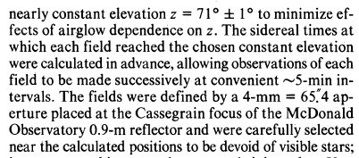
The Galaxy’s bulge/bar
Historically, we thought that the Milky Way had a regular R^{1/4} law bulge. ie de Vaucouleurs and Pence (1978) fitted this to ground-based optical photometry:
They derived an effective radius of 2.67 kpc.
Q: any observational issues?

Slide 22
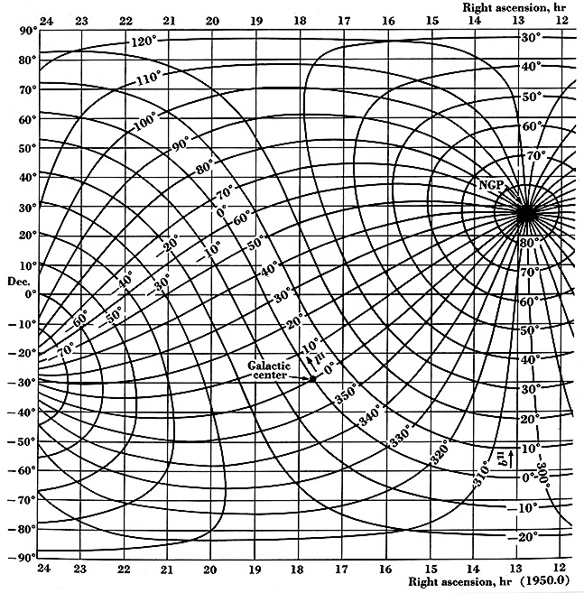
http://ned.ipac.caltech.edu/level5/rip1.jpg

Slide 23
R^{1/4} bulge?
However, even de Vaucouleurs classified the Milky Way (in the same paper) as a barred spiral: SAB(rs)bc

Slide 24
A bar!
Suggestions from gas kinematics (Binney et al 1991) and photometry (Blitz and Spergel 1991) were confirmed by the COBE satellite data (Dwek et al 1995): we live in a barred galaxy.

Slide 25
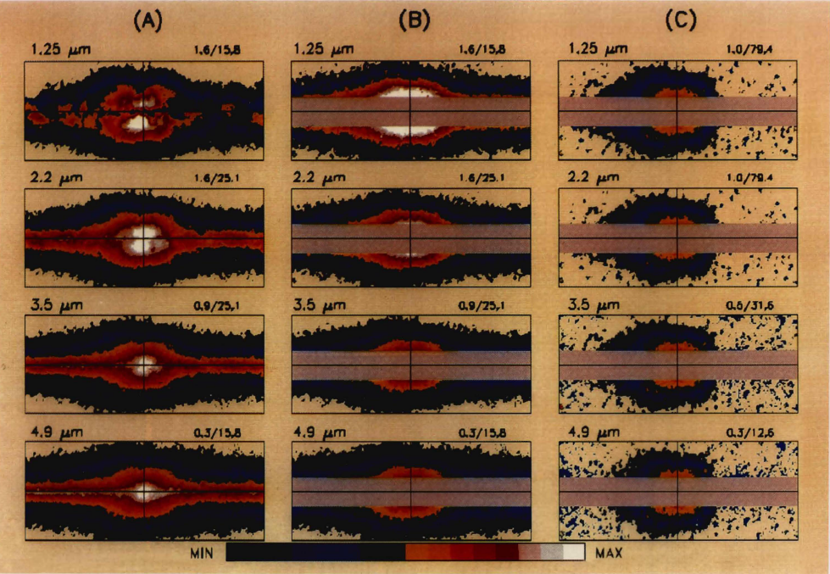

Slide 26
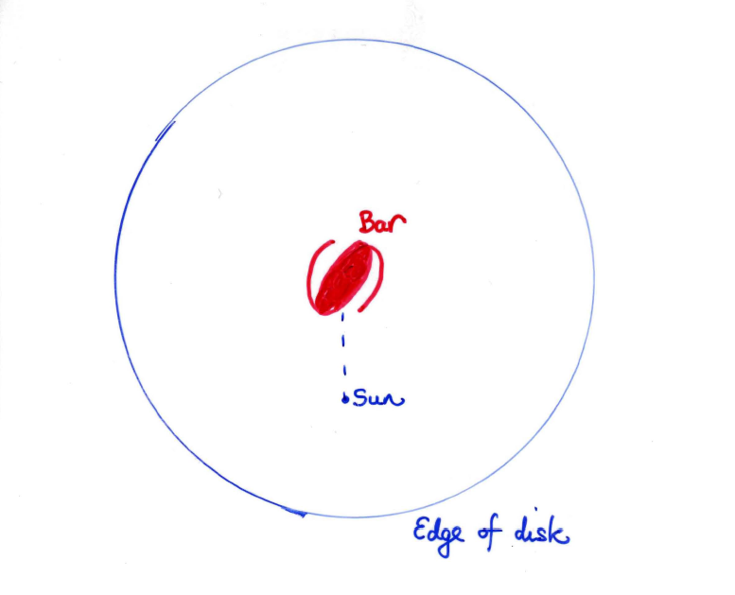
Orientation of bar wrt Sun

Slide 27
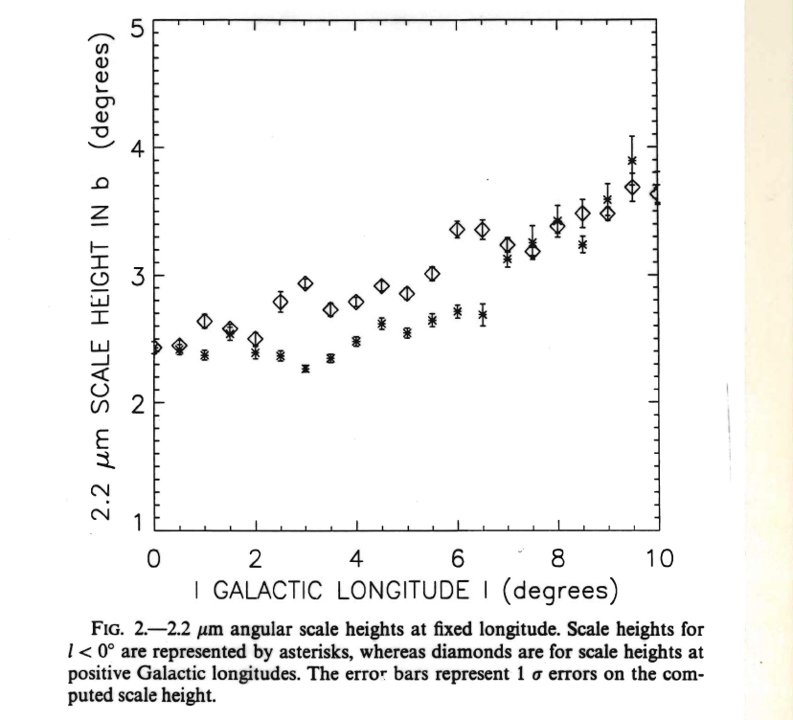
Perspective causes angular scale height to be larger on nearside

Slide 28
It’s hard to STOP disks forming bars
Movie from Prof Mihos

Slide 29
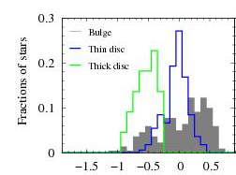
Age and metallicity
Bulge/bar stars are old: of order 10 Gyr
They are also metal-rich; more so than the disk near the Sun
However, so are inner disk stars
Hill et al 2011; note that thin and thick disk stars are from solar neighborhood

Slide 30
Summary
Originally it was thought that our Galaxy had an R^{1/4} bulge
We now know that it’s possible to model all the luminosity of the central regions by a bar
Since bars are dynamical states of a disk, we do not need a separate stellar population for the bulge; the bar is part of the inner disk
Many galactic astronomers still say ‘bulge’ which is confusing ☹

