Slide 1
Solar System Formation
The processes by which stars and planets form are active areas of research in modern astrophysics
The formation of our own solar system is central to the first half of our course, and important to the second half as well when we study the formation of stars

Slide 2
Astronomy/Astrophysics
Question:
How do you think astronomy might differ from other sciences? Why?

Slide 3
Hypotheses for Solar System Formation
Fall into two major categories:
The formation of the planets was tied to the formation of the Sun
The Sun was already there and something else formed the planets
Nebular Hypothesis (Kant, Laplace ~1700s)
The Sun and planets started as a blob of gas which cooled, collapsed and formed the Sun and planets (type (i) above)

Slide 4
Relevant data for formation theories
Question: What are some important and relevant trends in the Solar system that will help us test theories? Why?
Question: What parts of physics (chemistry?) will be useful? Which parts are less likely to be needed?

Slide 8
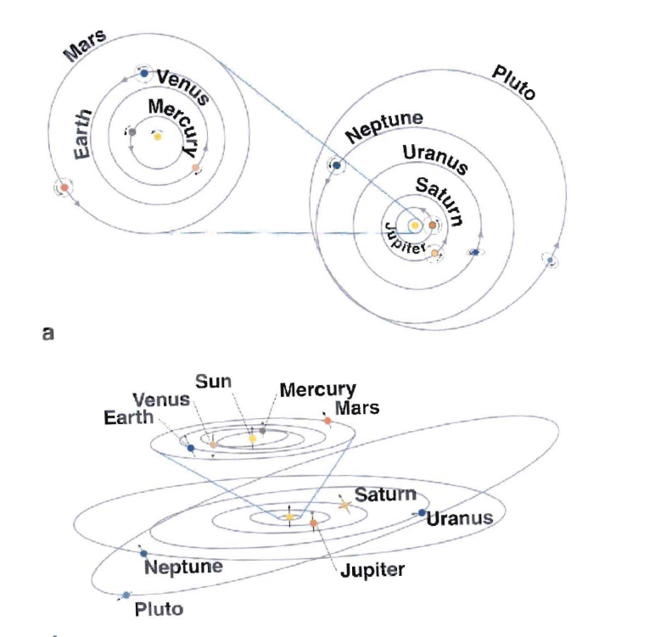

Slide 9
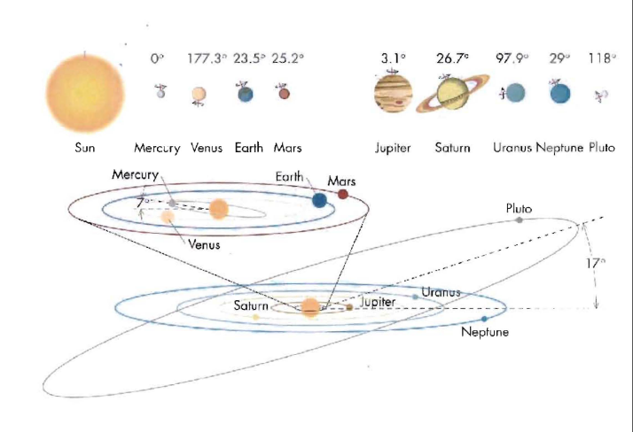

Slide 10
Important orbital trends
All planets orbit in close to the same plane (remember that Pluto is no longer considered a planet)
All planets orbit in the same direction, which is the same direction that the Sun rotates
These both suggest that the Solar system formed from the collapse of a single cloud, rather than from capturing passing material
(but see homework…..)

Slide 11
History of formation hypotheses
Despite these known trends, the Nebular hypothesis went out of fashion in the 1930s because
(a) A simple collapse which conserved angular momentum would cause the Sun to spin so fast it would break up, and
(b) If you distributed the current mass of the Solar System evenly through its volume, its density would be too small for it to collapse

Slide 12
Question:
What would cause a blob of gas to collapse gravitationally?
What would cause it to stay at its original size or expand?

Slide 13
Question:
What would cause a blob of gas to collapse gravitationally?
What would cause it to stay at its original size or expand?
If the gas is too hot, then its pressure will overcome gravitational inward force
If it can cool (by radiating) and is massive enough, gravity will win
This is known as Jeans Collapse (after Sir James Jeans)

Slide 14
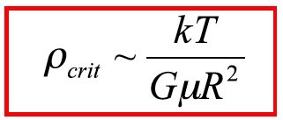
Increased density -> increased gravity -> more material gets sucked in -> runaway process (Jeans collapse)
Collapsing cloud
Gravitational potential energy
M,ρ
R
Thermal energy
Equating these two and using M~ρR³ we get:
M=mass ρ=density
k=Boltzmann’s constant
μ=atomic weight
N=no. of atoms
T=temperature (K)
Does this make sense?
Francis Nimmo UCSC

Slide 15
Angular momentum conservation
In an isolated system we expect angular momentum to be conserved
This was one of the big problems that astronomers in the early 1900s found with the nebular hypothesis: what sort of collapse could end up with most of the angular momentum in the solar system in Jupiter (biggish mass, big radius) but not in the Sun?

Slide 16
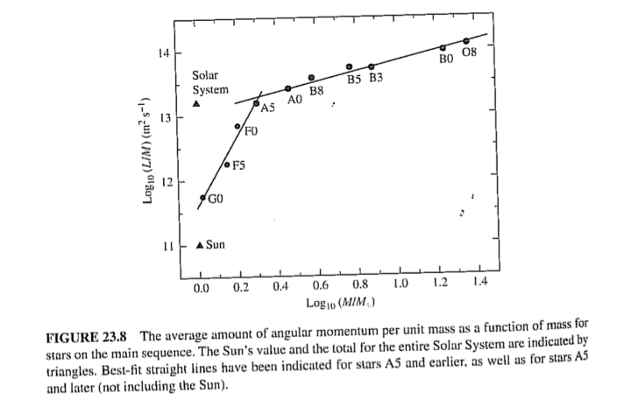
Lower mass stars
High mass stars
From Carroll and Ostlie

Slide 17
Angular momentum 2
The fact that the composition of meteorites is very close to that of the heavy elements in the Sun (and the abundance of different stars is different) was the reason astronomers returned to the nebular hypothesis
BUT angular momentum can be exchanged between different parts of the early solar system and we now think that is what happened, with the Sun losing a.m. via mass loss, magnetospheric interactions.

Slide 18
History of SS Formation theories 2
Theories of type (ii):
A passing star pulled some of the Sun’s atmosphere off via tidal forces. This former atmospheric material then coalesced and formed the planets (early 1900s)
The Sun captured material from passing interstellar clouds (1940s)

Slide 19
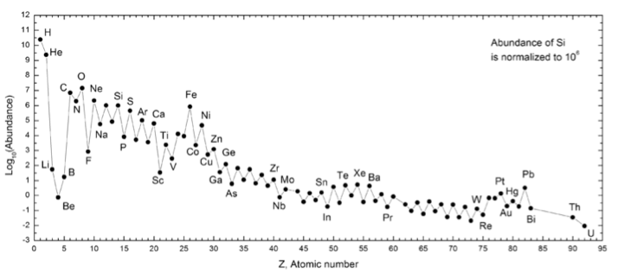
In ~1930 we learned that the Sun is almost all composed of H and He. If the early solar system had a similar makeup, gas might have escaped the early solar system, so the objection about the density being too low for gravitational collapse went away
Solar system abundances

Slide 20
Paths to planet formation
Two possibilities:
(i) Planets form like stars, from the gravitational collapse of gas clouds
(ii) (now preferred) Planets form by the aggregation of solid particles in a disk around a star, with or without gas

Slide 21
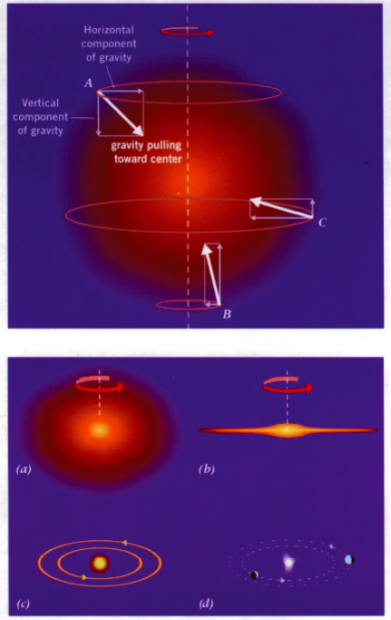
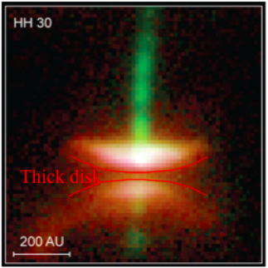
Nebular hypothesis
As the nebula that was to form the Sun collapsed, it spun up and formed a protoplanetary disk
We see disks around young stars today:

Slide 22
Common misconception:
The terrestrial planets are denser than the gas giants because the heavier elements in the early solar nebula fell toward the center
Question: give some everyday examples of heavy stuff falling faster than lighter stuff (think Pumpkin Drop…. then think of bubbles in champagne)
Question: Make an order of magnitude estimate of the density of the early solar system in g/cm^3

Slide 23
Mass of Sun / volume inside 40 AU
~ 10³³ g / (40 x 10¹³ cm)³ or 10⁻¹¹ g/cm³
(Density of water in cgs units is 1.0)
This is equivalent to a good vacuum on Earth.
There is no liquid phase at these densities and pressures; solids sublime directly to gas and vice versa.

Slide 25
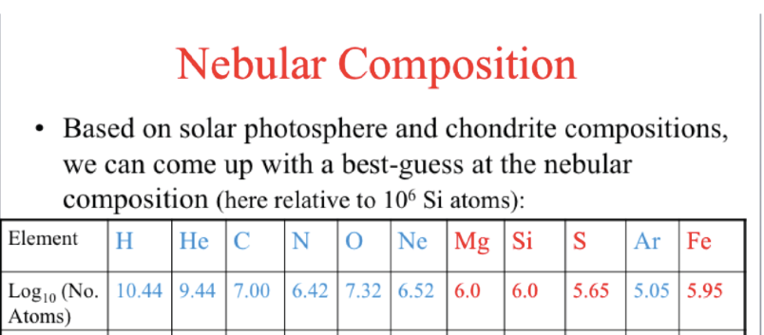

Slide 26
Condensation sequence
Some elements will always be gaseous at solar nebula temperatures, pressures (eg H, He)
Some elements will condense out only at low temperatures, far away from Sun (volatiles such as H₂O)
Some elements will condense out almost anywhere in the solar system (refractory elements and compounds such as Fe, FeS, minerals)

Slide 27
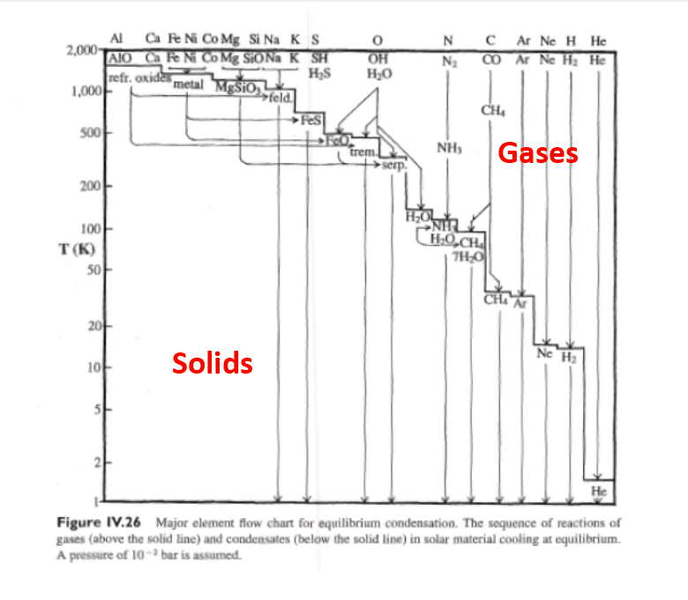

Slide 28
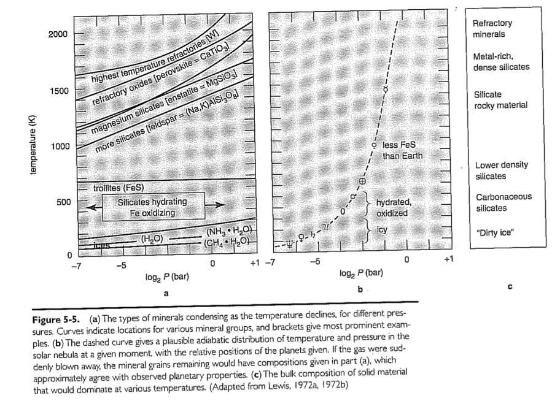
Phase diagrams
Hartmann “Moons and Planets”

Slide 29
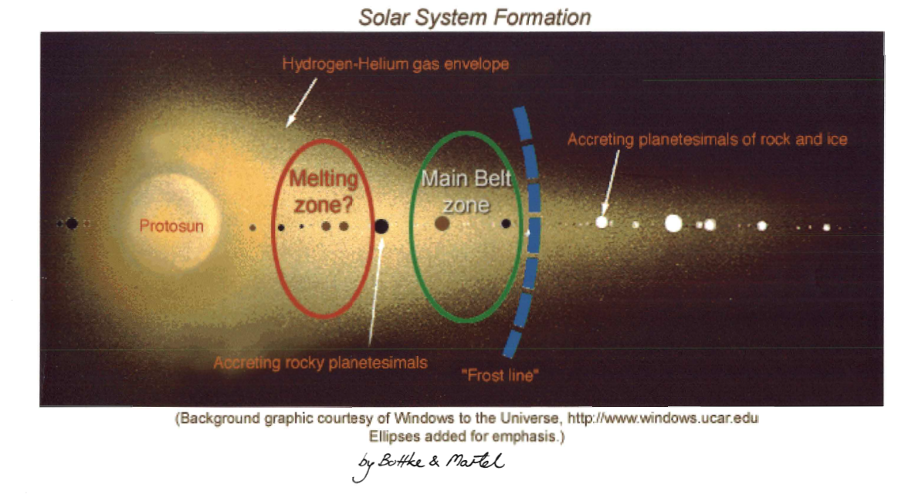
The Ice line

Slide 30
Giant planet formation
The giant planets started off with cores significantly larger than the terrestrial planets (say 10 Earth masses for Jupiter) since they live beyond the ice line and ices are much more common because they are made of lighter elements (H,C,N,O)
This extra mass allowed them to attract more H and He from the protosolar nebula

Slide 31
Planetismals and accretion
Start with the solar nebula: a disk of gas and dust surrounding the sun, with a temperature gradient
Microscopic grains will condense out as temperature allows:
-- silicates and iron compounds everywhere
-- water and other ices outside ‘ice line’
Grain sizes of order 1 micron
Grains settle to midplane of the nebula; collide, agglomerate, grow in size. In around 10^4 years, end up with km-sized objects: planetismals

Slide 32
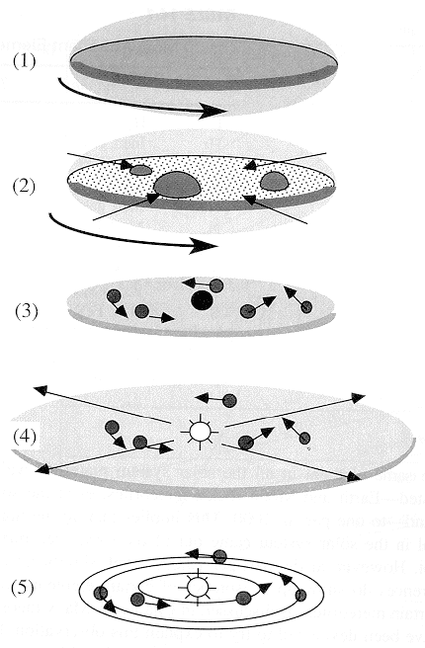
Sequence of events
1. Nebular disk formation
2. Initial coagulation (~10km, ~10⁴ yrs)
3. Runaway growth (to Moon size, ~10⁵ yrs)
4. Orderly growth (to Mars size, ~10⁶ yrs), gas loss (?)
5. Late-stage giant collisions (~10⁷⁻⁸ yrs)
Francis Nimmo UCSC

Slide 33
Accretion timescales
Consider a protoplanet moving through a planetesimal swarm. We have where v is the relative velocity and f is a factor which arises because the gravitational cross-sectional area exceeds the real c.s.a.
Question: why is it larger?
Planet
density ρ
v_{orb}
R
fR
Planetesimal
Swarm, density ρ_{s}
Francis Nimmo UCSC

Slide 34
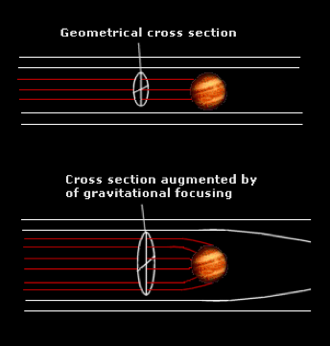
Gravitational focusing
Gravity moves the orbits of planetismals toward the massive object, which increases its effective cross-section

Slide 35
Accretion physics
f accounts for the gravitational focusing:
Planet
density ρ
v_{orb}
where v_{e} is the escape velocity, G is the gravitational constant, ρ is the planet density. So:
R
fR
Planetesimal
Swarm, density ρ_{s}
Francis Nimmo UCSC

Slide 36
Accretion timescales
Two interesting cases:
8GρR² << v² so dM/dt ~ R² which means all bodies increase in radius at same rate – orderly growth
8GρR² >> v² so dM/dt ~ R⁴ which means largest bodies grow fastest – runaway growth
So beyond some critical size (~Moon-size), the largest bodies will grow fastest and accrete the bulk of the mass

Slide 37
This gas accretion became a runaway process, especially for Jupiter and Saturn: cores got more massive, accreted more gas, got even more massive, etc
The process terminated when the solar system was cleared of gas

Slide 40
pp

Slide 42
Question: the terrestrial planets probably accreted some gas too, but our current atmospheres are not H and He. What would have helped them lose these primordial atmospheres?

Slide 43
Summary
Solar system formation tied closely to formation of the Sun
Disk of dust and gas settles to midplane
Planetismals accrete to form planets
Position in solar system (ice line) determines whether
-- the more abundant ices form planetary cores which then accrete gas to form giant planets
-- the less abundant refractory elements form the smaller terrestrial planets

Slide 44
Summary 2
The giant planets started off with larger cores because they included the more abundant volatile elements
This allowed them to accrete even more gas in what became a runaway process
The terrestrial planets lost any early atmospheres they had accreted because they were molten …. Energy gained from accretion

Slide 45
More questions
Question: How did the planets get into mostly circular orbits?
Hint: think of Kepler’s second law

Slide 46
Answer:
Gravity is a weak force, so things need to stay near each other for a while to aggregate. (this works for colliding galaxies too).
Planetismals on elliptical orbits will both have a higher chance of intersecting other stuff, and will also collide at higher velocity, making aggregation less likely and disintegration more.

Slide 47
Meteorites
Question: Given the current theory of solar system formation, how do you think that some meteorites are basically solid Fe?

Slide 48
Meteorites
Question: Given the current theory of solar system formation, how do you think that some meteorites are basically solid Fe?
Answer: Some body which was massive enough to become molten and then differentiate must have collided and broken into pieces

