Slide 1
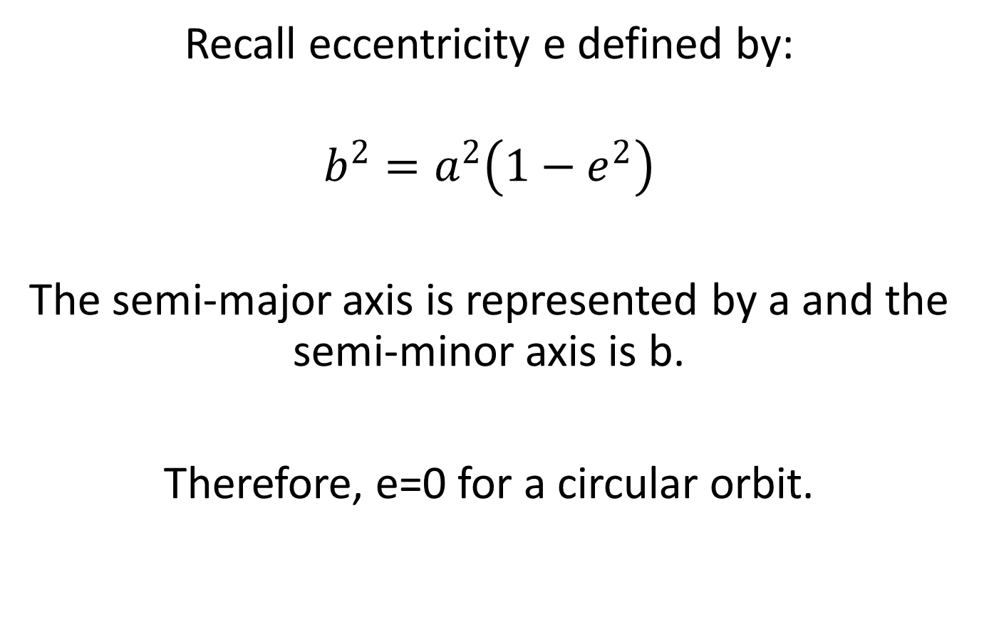
Planetary Orbits
Recall eccentricity e defined by:
$$b^{2}=a^{2}\left(1−e^{2}\right)$$
The semi-major axis is represented by a and the semi-minor axis is b.
Therefore, e=0 for a circular orbit.

Slide 2
Question:
Use the sheet of information below to summarize
the list of planets in order of:
eccentricity of orbit
inclination to ecliptic

Slide 4
Terrestrial Planets:
Mass (in Earth masses)
Mercury’s orbit is the most elliptical, and aligned at 7° to the ecliptic.
perihelion=0.31 AU aphelion=0.47 AU
The precession of Mercury’s orbit was one of the first successes of Einstein’s theory of general relativity.
Mercury | 0.06
Venus | 0.82
Earth | 1 (Moon = 0.01)
Mars | 0.11

Slide 5
http://hyperphysics.phy‐astr.gsu.edu/hbase/rela5v/grel.html#c3

Slide 6
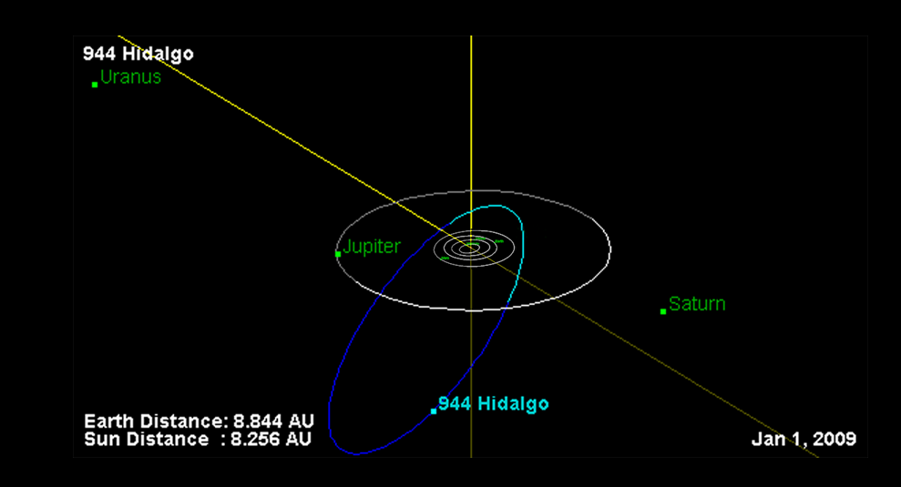
Asteroids:
Most asteroids orbit between Mars and Jupiter’s orbit, but two are known that travel at least as far as Saturn’s orbit:
944 Hidalgo:
  Has an eccentric orbit from just past Mars to near Saturn
  About 40 km across
  Discovered in 1920
  Orbital inclination
  of 43 degrees
  Close encounter with
  Jupiter in past?

Slide 7
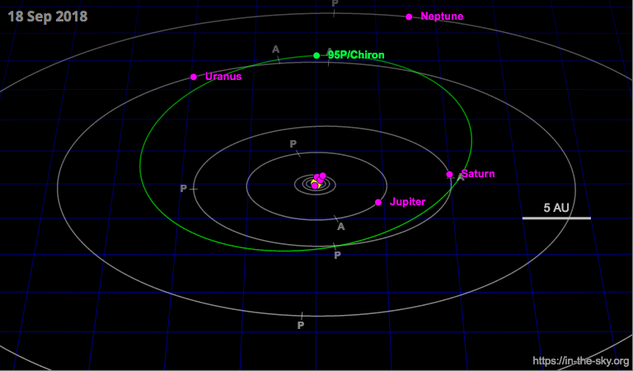
2060 Chiron:
  Orbit ranges from just inside Saturn to near Uranus
  About 180 km diameter
  Discovered in 1977
Chiron and Hidalgo are both examples of objects called Centaurs: bodies which orbit between the asteroid belt and the Kuiper belt

Slide 8
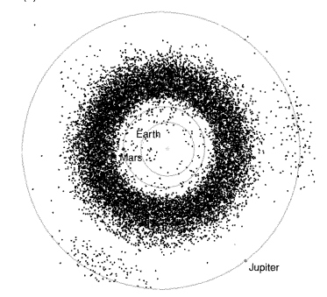
From Pater and Lissauer “Planetary Sciences”
A cross-section through the asteroid belt. Each individual asteroid shown moves in an orbit inclined to the ecliptic plane, so that sometimes it is above it, and sometimes below. You can imagine that collisions between asteroids will be quite common.

Slide 9
The orbits of known Potentially Hazardous Asteroids (PHAs). The orbit of Earth is also shown.

Slide 10
Question:
  In the minor planet center animation, there seems to be more asteroids close to the earth in its orbit, than 180° away.
  What do you think causes this?

Slide 11
Answer:
It’s hard to think of a physical reason for this, but it’s easier to think of a sociological one. Human beings are concerned about a possible direct hit on the earth by a large object. We search harder for objects whose orbit may cross the Earth’s, and work harder to derive the orbit of such objects. This causes an artificial enhancement on maps, which are of known objects.

Slide 12
Calculating orbits for asteroids
It is relatively simple to derive the orbit of an extrasolar planet (once the observations are accurate enough), but calculating the orbit of a newly discovered asteroid is tougher. In general, they are too faint to obtain velocities, so the data are simply a number of positions in the sky with times of observation.
Question:
How do you think astronomers actually calculate the orbit of a new asteroid?

Slide 13
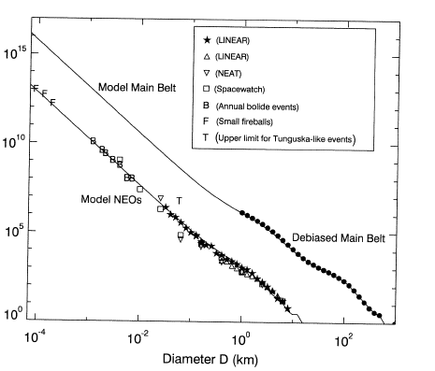
The cumulative size distribution of the known bodies in the asteroid belt, plotted logarithmically. The graph tells us the number of asteroids that have diameters greater than a given value.
“Debiased” means that the numbers have been corrected for observational biases
(Note Tunguska-type upper limit)
From Pater and Lissauer “Planetary Sciences”

Slide 14
Question:
Why are there so many more small asteroids?

Slide 15
Orbital resonances with Jupiter:
The asteroids are not evenly distributed between Mars and Jupiter. There are distinct gaps called the Kirkwood gaps. These are places where orbiter periods are of simple ratios with Jupiter, such as 8:1,2:1. since Jupiter is always in the same place every 2nd or 3rd orbit, it’s extra gravitational kick destabilizes orbits there.
There are also places of unusual gravitational stability, where more asteroids exist than expected. The Trojan asteroids are at the Lagrangian points L₄ and L₅. These describe positions in the restricted three-body problem that are very stable.

Slide 16
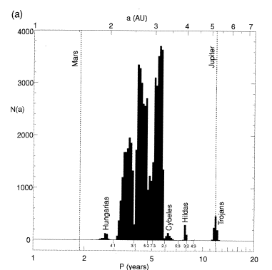
The radial distribution of asteroids in the asteroid belt, from Pater and Lissauer’s text. Asteroid group names and orbital resonances with Jupiter are also shown. Kirkwood gaps are evident at numerous resonance locations, and enhancements in the number of asteroids are apparent at other resonance locations.

Slide 17
Trojan asteroids are located in Jupiter’s orbit, either leading or trailing the planet by 60°. The occupied positions are two of the five Lagrangian points in the sun-Jupiter system.

Slide 18
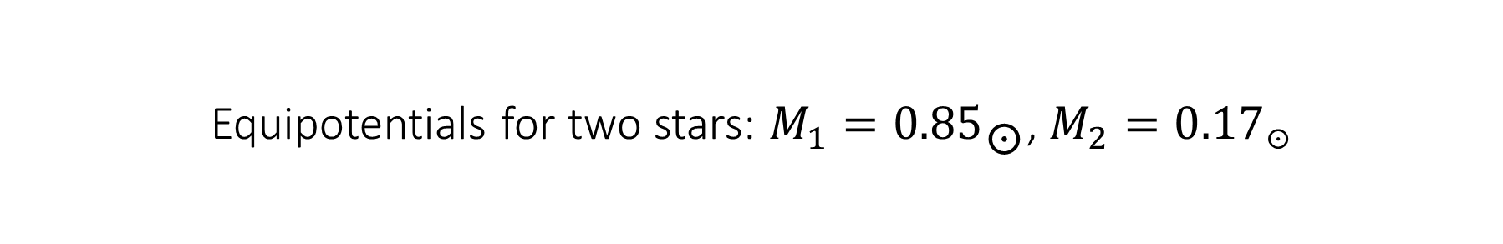
Equipotentials for two stars: $M_{1}=0.85☉$, $M_{2}=0.17☉$

Slide 19
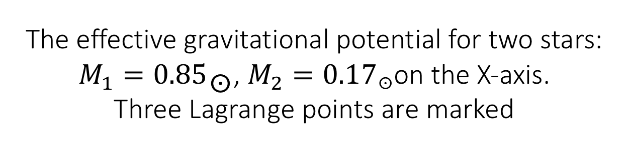
The effective gravitational potential for two stars: $M_{1}=0.85☉$, $M_{2}=0.17☉$on the X-axis.
Three Lagrange points are marked

