Slide 1
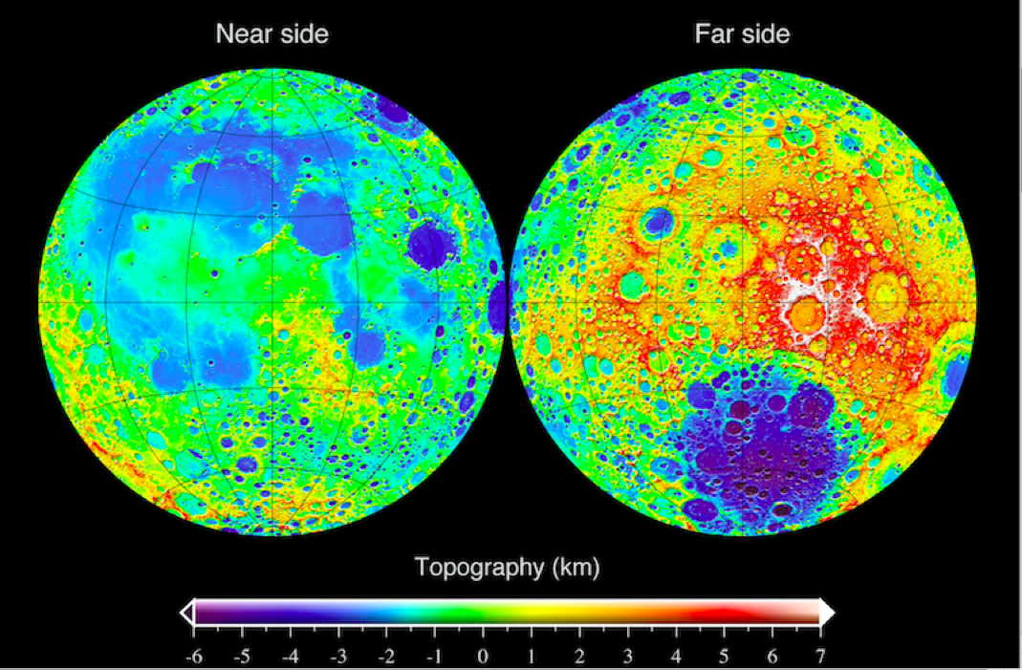
The Moon
Topographic map from Lunar Reconnaissance Orbiter

Slide 2
Basic data
Radius 0.27 of Earth’s
Mass 0.01 of Earth’s
Orbits Earth with period 27.3 days
Revolves on its axis with this period: tidally locked so one face always points towards the Earth
Orbital eccentricity 0.05, inclined 5 deg to ecliptic

Slide 3
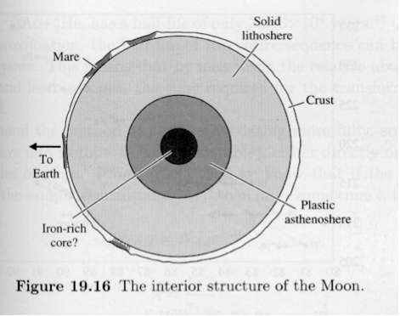
Surface and interior
Many craters, also dark patches called maria, which are mostly on the near side
The far side shows highlands
Maria are filled with (denser) basaltic rock while highlands are composed of less dense rock called gabbro
Moon has much smaller core than Earth; crust thicker on far side

Slide 4
Composition of moon rocks is very similar to that of rocks on Earth (similar origin?)
Moon’s crust has few volatile elements, unlike Earth – at one stage it must have been hot enough for long enough for volatiles to be boiled off

Slide 5
Origin of the Moon via giant impact
Canup (2004) made high-resolution simulations of the origin of the Moon via the impact of a Mars-sized object on the Earth, towards the end of the period when the Earth grew in mass by accretion of planetismals.
Impact velocity ~9 km/s
Impactor’s iron core is mostly re-accreted by Earth
Material from mantle orbits Earth and accretes to form the Moon

Slide 6
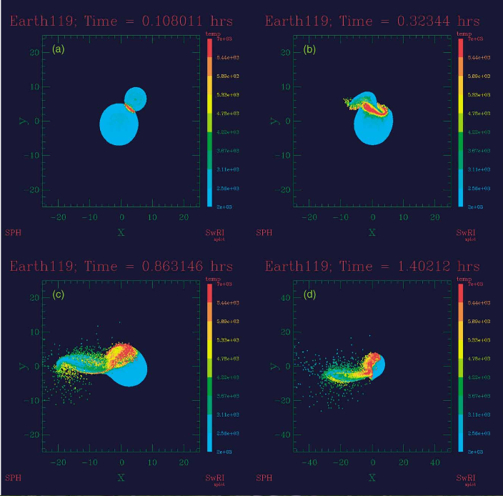

Slide 7
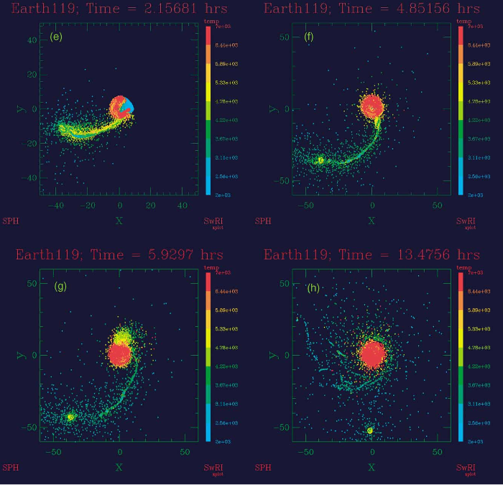

Slide 8
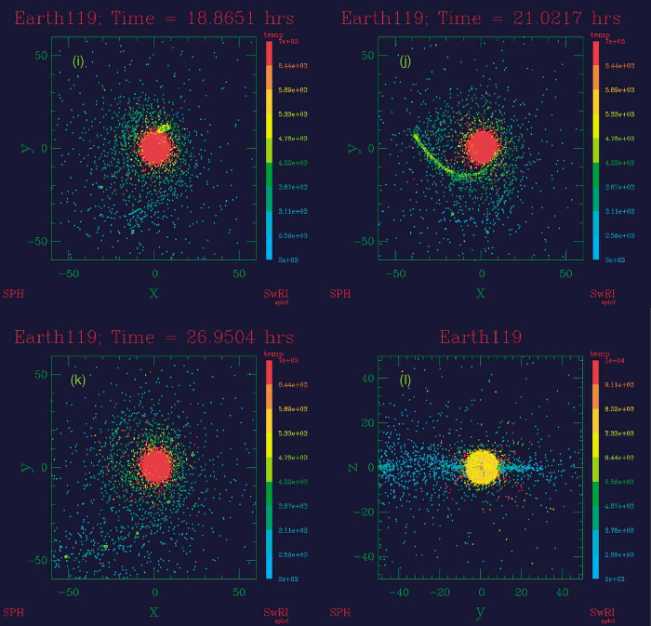

Slide 9
Late stages of formation, not shown in Canup simulations: debris accretes to form larger object plus a transient ring

Slide 10
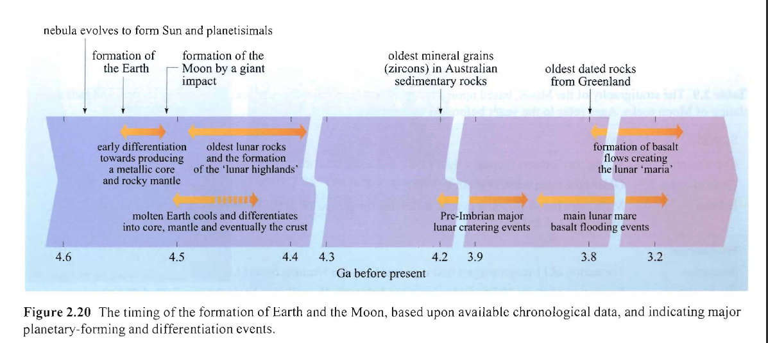
Timing of Earth and Moon formation

Slide 11
Heating and cooling
Q: What are the sources of heat in a planet or moon?

Slide 12
Heating and cooling
Q: What are the sources of heat in a planet or moon?
A: Accretion/impacts (potential energy)
Radioactivity
Tidal forces
Tidal forces can be neglected for the Moon compared to the other two (but not for Io!)
Because of the Moon’s small core, it will have less radioactive heat source than an object with a larger core (eg Mercury)

Slide 13
Heating and Cooling
While heat production will depend on a planet/moon’s volume (so go as R³), cooling will depend on its surface area (proportional to R²)
So large planets will cool more slowly than small ones
So we would expect to find more tectonic activity on large planets than, say, the Moon

