Slide 1
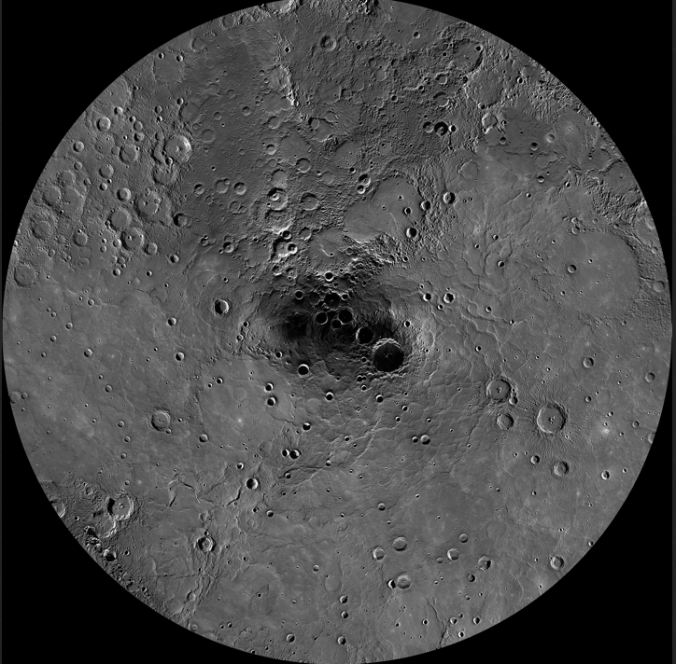
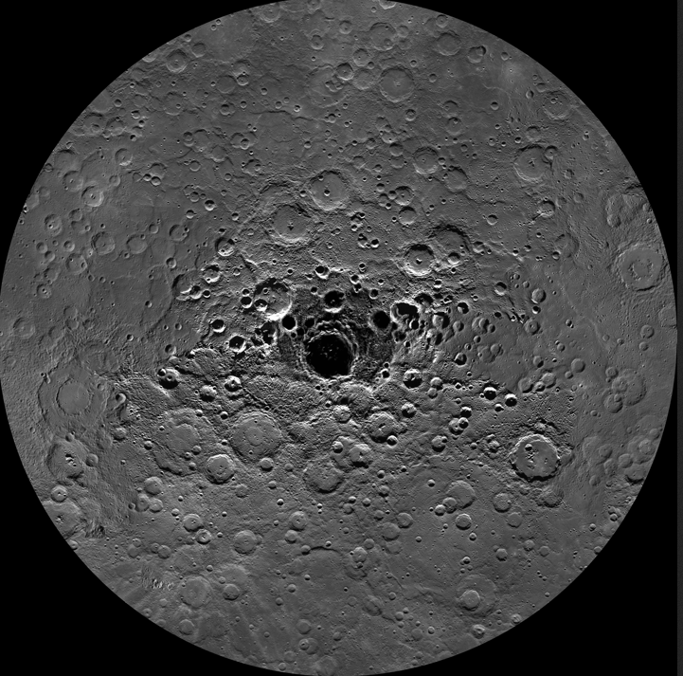
Mercury
North hemisphere
Basic data:
Radius is 0.38 of Earth’s
Mass is 0.06 of Earth’s
Orbit has e=0.2, a=0.39AU
Orbital period 88 days
Rotation period of Mercury
is 2/3 of this: 58.7 days
Atmosphere is effectively absent, but recently water and organic deposits have been found in north pole craters where sunlight never reaches
Basic data
South hemisphere from MESSENGER

Slide 2
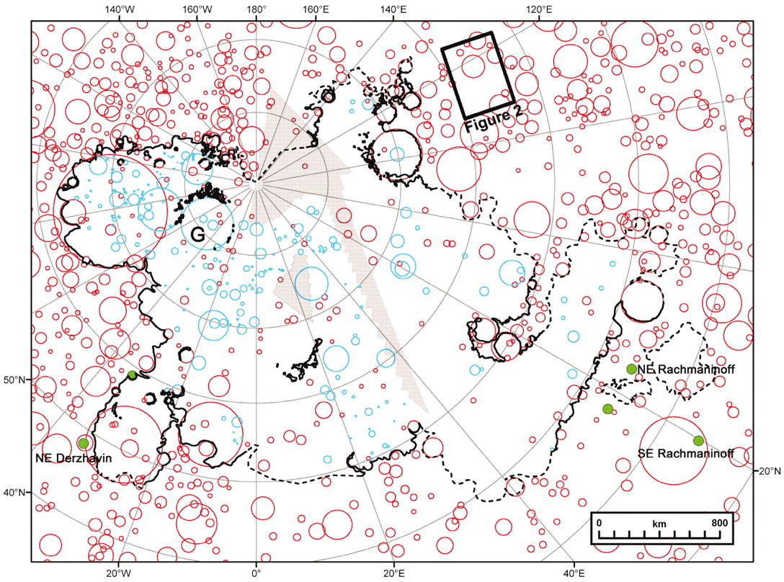
Lots of craters BUT evidence of “volcanic activity” from MESSENGER:
Smooth plains at high northern latitudes
Red circles: craters
Blue circles: ‘ghost’ craters covered by volcanic outflows
J W Head et al. Science 2011
Published by AAAS
Notes:
Distribution of smooth plains and adjacent older units at high northern latitudes on Mercury. Smooth plains are outlined in black (solid, certain; dashed, approximate); impact craters >20 km in diameter are denoted by red circles (13), ghost craters within the plains by blue circles (the letter G denotes the Goethe basin), and pits and pyroclastic deposits by green dots [including named features (6) and others newly recognized]. Gray areas denote gaps in MDIS imaging coverage as of this writing. Major trends of wrinkle ridges in the region are given in fig. S1.

Slide 3
Question:
Does evidence for part of the planet being molten in the past mean evidence for plate tectonics, or could other things cause melting of a planet’s surface?

Slide 4
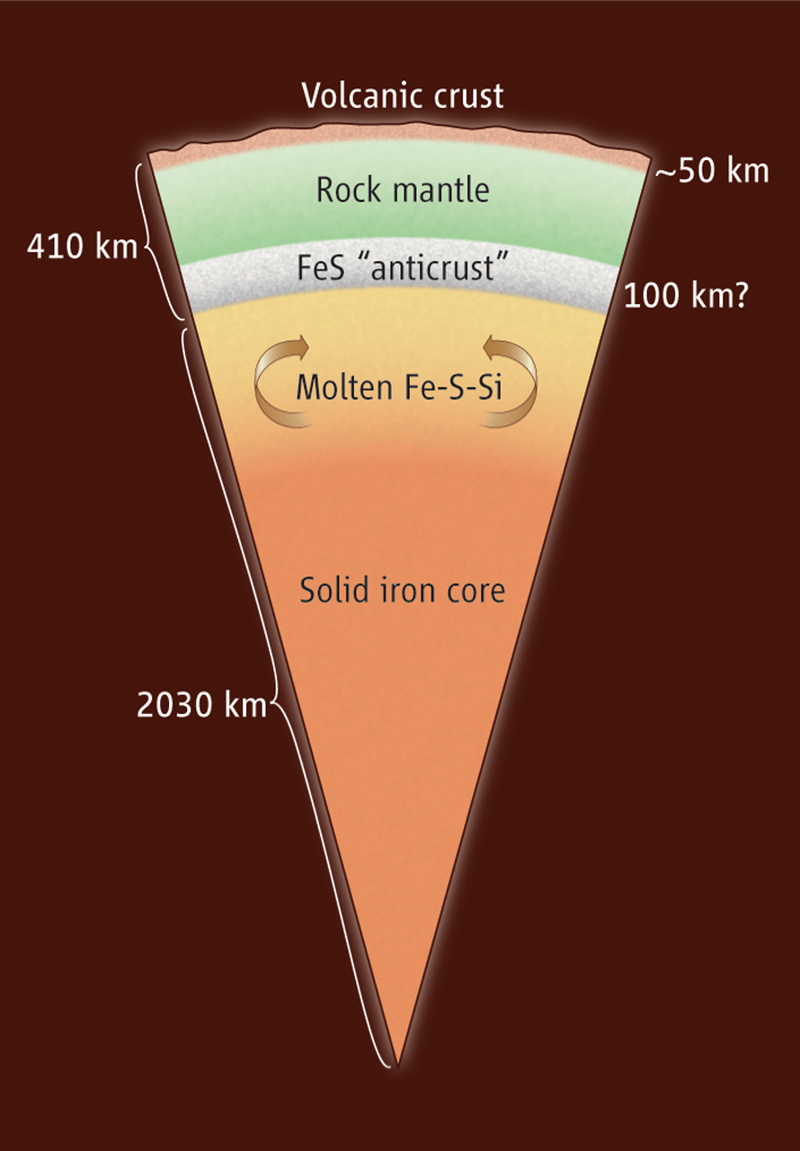
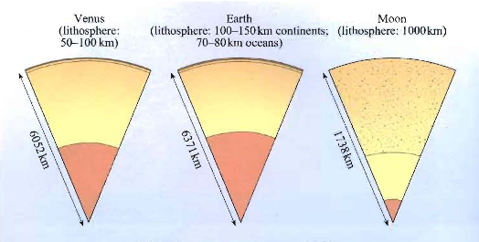
Once internal compression is taken into account, larger density than Earth
Mapping by CWRU’s Steve Hauck has shown that it has a much smaller mantle and larger core than other terrestrial planets
Mercury has a magnetic field due to motions in molten core
W B McKinnon Science 2012
Published by AAAS
Notes:
Inside Mercury.Recent measurements suggest a rather unusual interior structure for Mercury. The rocky mantle is comparatively thin and is sandwiched between a surface volcanic crust and an underplated iron-sulfide “anticrust.” The size of Mercury's likely inner core of solid iron (plus dissolved metallic silicon) is poorly constrained, as are possible immiscible zones in the molten outer core. How much of Mercury's crust is volcanic, and how much (if any) may be a primitive flotation crust, is also unknown.

