Slide 1
Orbits and Kepler’s Laws
Kepler's laws: apply to planets around the Sun, moons around planets, comets, binary stars
The planets move in elliptical orbits with the Sun at one focus:
$Ellipticity \left(e\right): b^{2}=a^{2}\left(1−e^{2}\right)$
a is the semi-major axis
b is the semi-minor axis

Slide 2
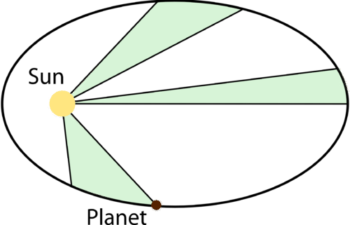
Orbits and Kepler’s Laws
A line from the Sun to a planet sweeps out equal areas in equal times.

Slide 3
Orbits and Kepler’s Laws
3. More distant planets orbit the Sun at slower average speeds, obeying a precise mathematical relationship.
${The Harmonic Law:p}^{2}=a^{3}$
p is the planet’s orbital period in years
a is its average distance from the sun in Astronomical Units (AU)

Slide 4
Center of Mass
The Earth and the Sun both orbit around their common center of mass.
Putting the center of mass at the origin:
$$MR=−mr;$$
Reduced mass $μ=\frac{mM}{m+M}$

Slide 5
Center of Mass
So a more correct statement of Kepler’s first law is:
Each planet moves on an elliptical orbit with the center of mass at one focus.
Question:
The Sun has a mass of 2×10³⁰ kg and the Earth has a mass of 6×10²⁴ kg.
1 AU = 1.5×10¹¹ m; The Sun’s radius is 7×10⁸ m
Is the Sun-Earth’s center of mass inside the Sun or outside?

Slide 6
Question:
Prove Kepler’s second law, using conservation of angular momentum.
(Use a circular orbit for simplicity)
Hint: draw a diagram
Hint: What area is swept out in time dt?
Hint: Angular momentum $L= \overset{⃑}{r}×\overset{⃑}{p}$

Slide 7
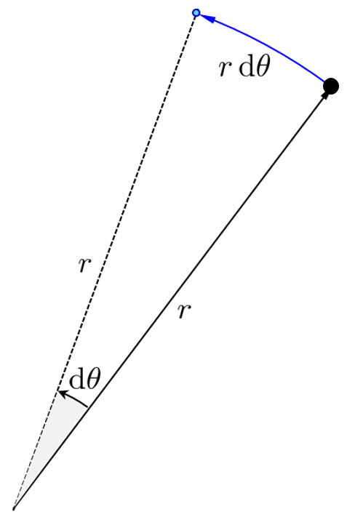
In time dt, a planet moves an angle dϴ along its orbit.
Area of wedge is $\frac{1}{2}r∙rdθ$
Distance moved = $v_{θ}dt=rdθ$
So area$= \frac{1}{2}r∙v_{θ}dt$

Slide 8
Angular momentum: $\overset{⃑}{L}=m\overset{⃑}{r}×\overset{⃑}{v}$
$$L=mrv_{θ}$$
Conservation of angular momentum at any point:
$m_{1}r_{1}v_{θ_{1}}=$ $m_{2}r_{2}v_{θ_{2}}$
The planet’s mass is unchanged, so:
$$r_{1}v_{θ_{1}}=r_{2}v_{2}$$

Slide 9
In time t:
$area$ =$\int_{0}^{t}{\frac{1}{2}}rv_{θ}dt$
Since $rv_{θ}$ doesn’t change along the orbit, neither does the area.
So Kepler’s second law is simply a statement that angular momentum is conserved in the Solar System

Slide 10
Energy of Orbits
Question:
What are the two major contributions to the Earth’s orbital energy?

Slide 11
Energy of Orbits
Question:
What are the two major contributions to the Earth’s orbital energy?
Answer:
Kinetic and potential energy

Slide 12
Kinetic energy:
$$K=\frac{1}{2}mv^{2}$$
Gravitational Potential Energy:
Since the gravitational force is a central force, energy is conserved and we can define potential energy.
Derive formula for gravitational p.e:
What is the work involved in pushing a planet away from the Sun?
Using vector notation:
$$∆ U=\int_{{\overset{⃑}{r}}_{i}}^{{\overset{⃑}{r}}_{f}}{\overset{⃑}{F}}∙d\overset{⃑}{r}$$

Slide 13
Using the gravitational force law and the fact that $\overset{⃑}{F}$ and $\overset{⃑}{r}$ are in the same direction:
$$∆U = \int_{r_{i}}^{r_{f}}{\frac{GMm}{r^{2}}}dr$$
Integrating: $U_{f}−U_{i}= −GMm\left(\frac{1}{r_{f}}−\frac{1}{r_{i}}\right)$
Pushing all the way to $∞$ and defining $U\left(∞\right)=0$
$U=−\frac{GMm}{r}$

Slide 14
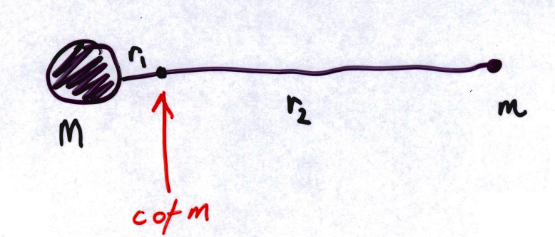
Looking at an asteroid in orbit around the Sun:
Total energy of the system:
$$E_{tot.}=\frac{1}{2}Mv_{Sun}^{2}+\frac{1}{2}Mv_{asteroid}^{2}− \frac{GMm}{\left(r_{1}+r_{2}\right)}$$
Define $r_{1}+r_{2}=r v_{asteroid}=v$

Slide 15
Question:
We can ignore the term for the Sun’s K.E. here. Why?
Answer:
$$Velocity=\frac{2πr}{p}$$
P is the period (same for both)

Slide 16
So $\frac{K.E.\left(Sun\right)}{K.E.\left( asteroid\right)}=\frac{Mv_{☉}^{2}}{mv^{2}}$
$$\frac{v_{☉}}{v}=\frac{r_{1}}{r_{2}} \& \frac{r_{1}}{r_{2}}=\frac{m}{M} ( center of mass)$$
Therefore $\frac{K. E.☉}{K.E.\left( asteroid\right)}=\frac{m}{M}∙\frac{m^{2}}{M^{2}}=\frac{m}{M}≪1$
So $E_{Tot.}=\frac{1}{2}mv^{2}−\frac{GMm}{r}$

Slide 17
For a circular orbit:
$$v=\frac{2πr}{p}$$
Kepler’s third law in full form:
$$p^{2}=\frac{4π^{2}r^{3}}{GM},\left(a↔r here\right)$$
We can use this formula to estimate the mass of an object once we have something orbiting it

Slide 18
So $v^{2}=\frac{4π^{2}r^{2}}{p^{2}}=\frac{GM}{r}$
And $kinetic energy=\frac{1}{2}mv^{2}=\frac{GmM}{2r}$
(Same formula applies for ellipse, semi-major axis $a↔r)$

Slide 19
We can now simplify the formula for the total energy:
$$E_{Tot.}=\frac{1}{2}mv^{2}−\frac{GMm}{r}$$
$$E_{Tot.}=\frac{gMm}{2r}−\frac{GMm}{r}$$
$$E_{Tot.}=\frac{−GMm}{2r}$$
$$E_{Tot.}<0→bound$$
Formula holds for any bound orbit, using a (semi-major axis) for r.
$→E_{Tot.}$ Depends only on a, not eccentricity.

Slide 20
Three orbits, with the same semi-major axis but different eccentricities, have the same amount of orbital energy.

Slide 21
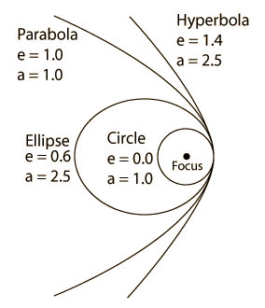
Closed orbits are in the shape of ellipses; as the energy increases, the orbit stretches out towards infinity until the orbit is a parabola and the body escapes.

Slide 22
For all bound orbits:
$$\frac{1}{2}mv^{2}−\frac{GMm}{r}= −\frac{GMm}{2a}$$
Where r is the present radius,
And a is the semi-major axis of the ellipse.
Mass m cancels: orbit is the same for Jupiter or a matchbox, it depends on M (Sun’s mass) and a.
Total orbital energy doesn’t change but K and U trade off.
General formula for circular velocity:
$$v=\sqrt{\frac{GM}{r}}$$

Slide 23
You can use these formulae to work out speed and period of the Hubble Space Telescope, in its low-Earth orbit (600 km from the surface).
$$v_{circ.}=\sqrt{\frac{GM_{Earth}}{r}}$$
$$=\sqrt{\frac{6.67×{10}^{−11}×6×{10}^{24}}{\left(6378+600\right)×{10}^{3}}}$$
=7.6 km/s
$$p=\frac{2πr}{v_{c}}=96 min.$$

Slide 24
Escape Velocity:
Take a satellite in orbit about the earth. If it burns fuel and increases total energy, eventually total energy will be zero and it will no longer be bound to the earth.
$$K.E.+P.E.=0$$
$$\frac{1}{2}mv^{2}−\frac{GMm}{r}=0$$
$$v^{2}=\frac{2GM}{r}$$
$$or v_{esc.}=\sqrt{\frac{2GM}{r}}$$

Slide 25
At the surface of Earth: $v_{e}= 11 km/s$
Escape velocity from the solar system at 1AU:
$$\sqrt{\frac{2GM_{☉}}{1AU}}=4.2×{10}^{6}\frac{cm}{s}=4.2×{10}^{4}\frac{m}{s}=42\frac{km}{s}$$
Question:
What is the escape velocity from the solar system at the surface of the Sun ?
For comparison, the Sun’s orbital motion about the center of the Galaxy is$\sim$ 220 km/s.

Slide 26
Synchronous Satellites:
Escape velocity is $\sqrt{2}×$ circular velocity at the same r.
$$⊙^{r} velocity: v_{c}=\sqrt{\frac{GM}{r}}$$
Synchronous satellite:
Takes 1 day to complete ITS orbit, going in same direction as Earth’s rotation, so it appears fixed above one point.

Slide 27
Distance from Earth?
Kepler’s third law: $p^{2}=\frac{4π^{2}a^{3}}{GM_{earth}}$
Period = 1 day = 24×3600s
Solve for a: $a^{3}=\frac{p^{2}×g ×M_{earth}}{4π^{2}}=\frac{{\left(24×3600\right)}^{2}×6 .7×{10}^{−8}×6×{10}^{27}}{4π^{2}}$
$$a= 4.2×{10}^{9} cm or 42,000 km$$
Earth’s radius is 6378 km, so this is about 35,600 km above the surface.
Quite different from low-Earth orbit!

Slide 28
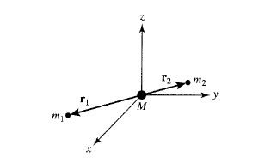
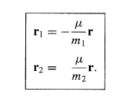
Kepler’s second law revisited:
Working in the center of mass frame
Now use $m_{1},m_{2},{\overset{⃑}{r}}_{1,}{\overset{⃑}{r}}_{2},{\overset{⃑}{v}}_{1},{\overset{⃑}{v}}_{2}$
Reduced mass $μ=\frac{m_{1}m_{2}}{m_{1}+m_{2}}$

Slide 29
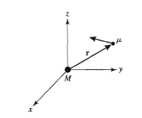
Total orbital angular momentum of the system:
$$\overset{⃑}{L}=m_{1}{\overset{⃑}{r}}_{1}×{\overset{⃑}{v}}_{1}+m_{2}{\overset{⃑}{r}}_{2}×{\overset{⃑}{v}}_{2}$$
This reduces to:
$$\overset{⃑}{L}=μ\overset{⃑}{r}×\overset{⃑}{v}$$
In general, the two-body problem may be treated as a one-body problem with the reduced mass mu moving about total mass M located at radius r

