Slide 1
Extrasolar planets
Q:
Why has it taken astronomers so long to find planets around other stars? What are the observational difficulties?

Slide 2
Extrasolar planets
Q:
Why has it taken astronomers so long to find planets around other stars? What are the observational difficulties?
A:
Stars outshine their planets an enormous amount in the optical and the near IR.

Slide 3
Detecting exoplanets
Andrew Howard, Caltech

Slide 4
Doppler search
NASA exoplanets site

Slide 5
Known extrasolar planets in 2014: a study in selection biases Winn and Fabrycky 2015

Slide 6
Hot Jupiters – first to be discovered with Doppler searches, but RARE
Andrew Howard, Caltech

Slide 7
Andrew Howard

Slide 8
Andrew Howard, Caltech

Slide 9
Formation of hot Jupiters
It is likely that these Jupiter-mass planets form at several AU (as in our Solar System) and then migrate close in to their star, by either dissipative interactions with the protoplanetary disk or by planet-planet interactions
Thus their existence is not a challenge to the condensation theory of planet formation

Slide 10
Andrew Howard
Caltech

Slide 11
Q:
How is the fact that metallicity (the abundance of elements heavier than He) helps form planets a clue to planet formation?

Slide 12
Q:
How is the fact that metallicity (the abundance of elements heavier than He) helps form planets a clue to planet formation?
A:
Planetary cores are formed of elements which can be solid in protoplanetary disks, ie elements heavier than H and He. Higher metallicity stars will find it easier to form these cores.

Slide 13
Transit method

Slide 14
NASA exoplanets site

Slide 15
Transit observations
Q:
how can we use the light curve to infer the size of the planet?

Slide 16
Andrew Howard Caltech

Slide 17
Observations are (just) reaching Earth mass

Slide 18
How about the majority of planetary systems?
Observations are just allowing us to detect Earth-mass planets.
Plot shows percent of systems with a given planet size, from Howard (2013)
These numbers are corrected for selection effects from how the planets were found
Smallish planets are more common than large ones!

Slide 19
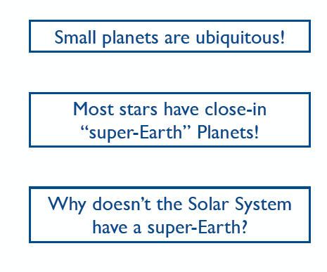
Howard 2013

Slide 20
What are these super-Earths anyway?
Andrew Howard

Slide 21
Howard et al 2013 show masses and radii of well-studied planets. Solar system objects are in green
Q: what are the objects which are way above the model for a pure H planet?

