Slide 1
Plate tectonics on Earth

Slide 2
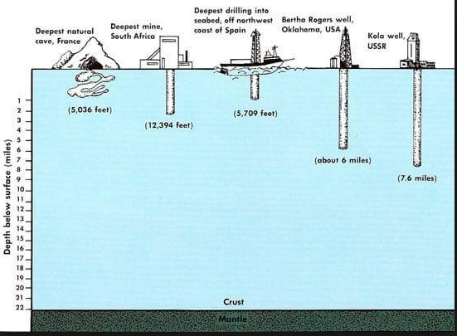
How do we study the interior of Earth?
Dig?
Oceanic crust 3-5 miles thick; continental crust 20-30 miles
Notes:
Radius of earth is

Slide 3
Earth’s interior
Deepest hole dug in Russia is ~10 km deep, Earth radius is 6,378 km
Volcanos have brought material from a few 100 km deep to the surface
For anything deeper we need seismology
Both earthquakes and underground explosions propagate waves through the Earth

Slide 4
Question: Will an underground nuclear test work as well as an earthquake for studying the Earth’s interior?

Slide 5
Question: Will an underground nuclear test work as well as an earthquake for studying the Earth’s interior?
Answer: Yes. Anything that causes waves to propagate will do. The Apollo astronauts left several seismometers on the surface of the (tectonically inactive) Moon. We did not learn as much as we had hoped because of a shortage of moonquakes. Most of the seismic waves detected were caused by meteor impacts.

Slide 6
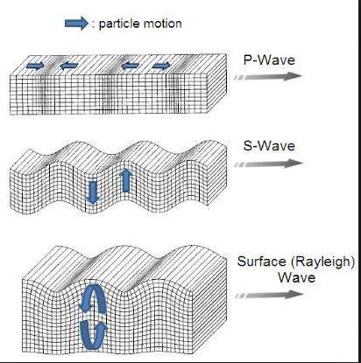
Three major types of seismic waves
P or pressure waves
S or shear waves
Surface waves – no use for studying interior

Slide 7
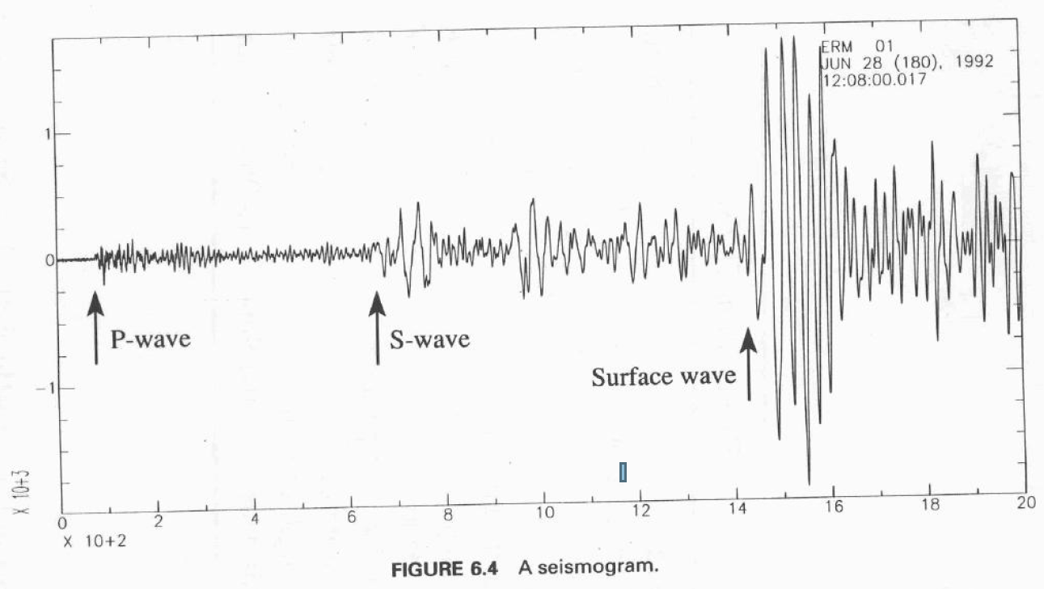
Seismogram

Slide 8
Velocity of seismic waves through the Earth – no S waves in liquids

Slide 9
Evidence for liquid outer core

Slide 10
Question:
Why might part of the Earth’s core be liquid when its surface is solid?

Slide 11
Question:
Why might part of the Earth’s core be liquid when its surface is solid?
Answer: The center of the Earth is warmer than its surface BUT the pressure is much higher there
Question:
What might be the original source of this heat?

Slide 12
Question:
Why might part of the Earth’s core be liquid when its surface is solid?
Answer: The center of the Earth is warmer than its surface
Question:
What might be the original source of this heat?
Answer:
The Earth assembled from planetismals and there was potential energy released from this assembly. Also its center contains heavy radioactive elements whose decay deposits heat

Slide 13
Q:
What are some of the pieces of evidence for the plate tectonics theory? Divide these into recent (after 1960s) and older evidence

Slide 14
Older evidence
Shapes of continents
Similar plant species separated by a large ocean (eg South Africa, Australia)
Similar rock patterns separated by oceans

Slide 15
Sea floor depths: Tharp-Heezen World Ocean Floor Map (1950s)

Slide 16
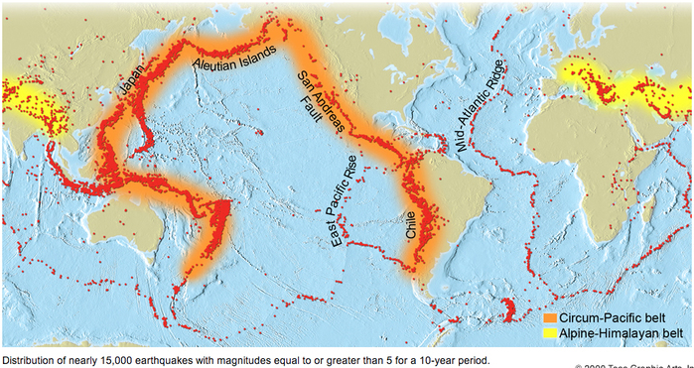
Position of earthquakes
http://platetectonicsalvin.weebly.com/earthquake-and-volcano-distribution.html

Slide 17
…. And volcanoes

Slide 18
Newer evidence: rocks show history of magnetic field reversals

Slide 19
Movie of mid ocean ridge

Slide 20
Rock ages in ocean floor
100 Myr (old) 10 Myr (young)
NOAA

Slide 21
Direct measurement of plate motions using GPS

Slide 22
Plate tectonics: basic concepts
About 10 rigid plates form lithosphere (crust)
They move with speeds from 2-10 cm/year
As the sea floor spreads at mid ocean ridges, lava rises to fill crack
This pushes continents apart
Subduction (one plate under the other) where plates meet
Volcano/mountain formation

Slide 23
