Slide 1
Comets and Asteroids: Orbits
Comets and asteroids are particularly interesting because of their resemblance to planetisimals: the building blocks of the Solar System.
Asteroids are rocky, and most are found between Mars and Jupiter.
Comets are outer solar system objects with elliptical orbits and contain mostly ice.

Slide 2
Question:
Do you think it is a coincidence that rocky asteroids are found near the rocky planets and icy comets near gas giants?

Slide 3
Answer:
Asteroids and comets are formed where they spend most of their time (inner solar system for asteroids, outer for comets). We would expect them to reflect the conditions there when they were formed.
The inner solar system was too hot for ices to be solid, so asteroids are rocky.

Slide 4
Question:
However, the split between comets and asteroids is less absolute than the terrestrial planet/gas giant division. What else might be going on? Should we disregard the condensation versus temperature theory we talked about last week?

Slide 5
Answer:
We don’t need to toss it out, but should recognize that the theory describes conditions in the early solar system.
Anything that modifies orbits afterwards will mess up these correlations. We have talked before about the Kirkwood gaps, where resonances with Jupiter have cleared out regions in the asteroid belt because objects there get an extra gravitational kick over and over again from Jupiter.

Slide 6
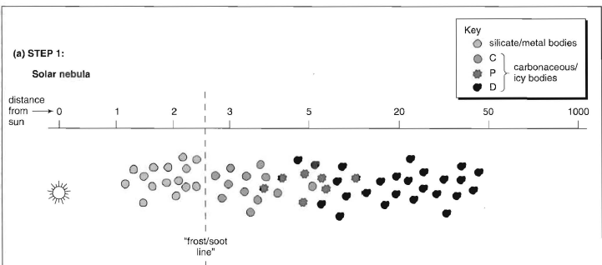
Timesteps in solar system formation/evolution:

Slide 7
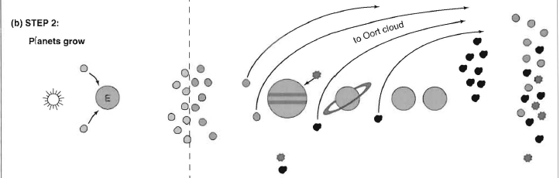
Creation of Oort cloud via giant planet interactions

Slide 8
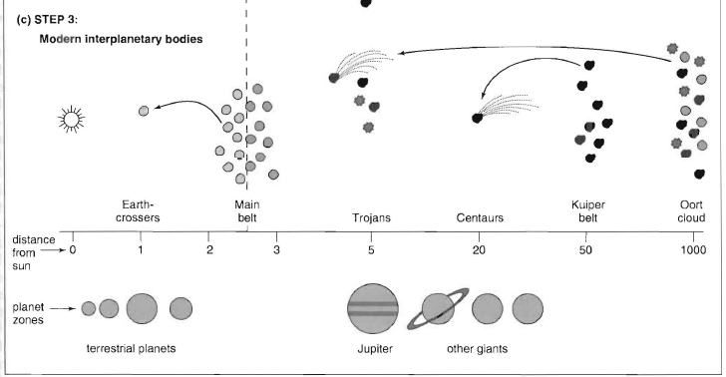
Solar system today

Slide 9
Comets
Comets have eccentric orbits and spend most of their time in the outer Solar System.
When far from the Sun, they are balls of ice and dust 1-10 km across.
As the orbit nears the Sun, around 3 AU, heat from the Sun evaporates some of the comet. This forms the coma.
The coma becomes two tails, which point in different directions:
One is an ion tail. For example: CO⁺,N₂⁺,CO₂⁺.
  The ion tail interacts with the solar magnetic field.
The dust tail is smoother.
  The dust tail is repelled from the Sun by radiation pressure and left behind along the comet’s orbit.

Slide 10
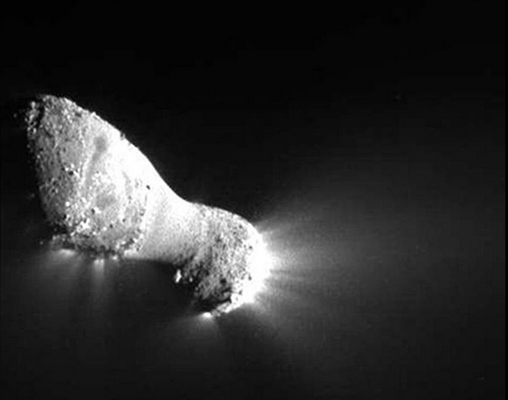
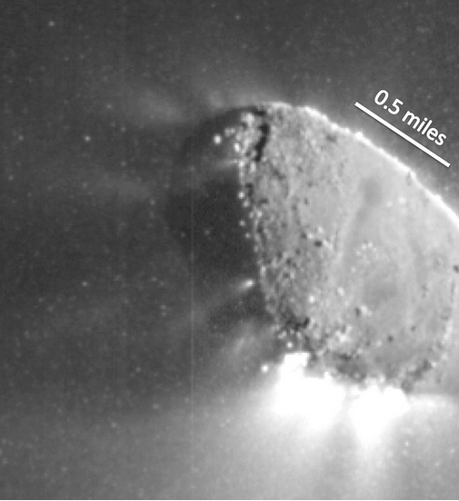
Periodic comet 103P/Hartley
Comet is ~2 km long. Note similarity to Halley movie, and gas and snow jets below

Slide 11
Question:
Why do periodic comets often seem fainter on progressive returns to the inner Solar System?

Slide 12
Answer:
On each perihelion passage, the comet loses more volatiles to its coma and tail. Some of these will remain strung out along the comet’s orbit.
After several passages, there will be less volatiles available to contribute to the coma and tail. This causes the comet to appear fainter.

Slide 13
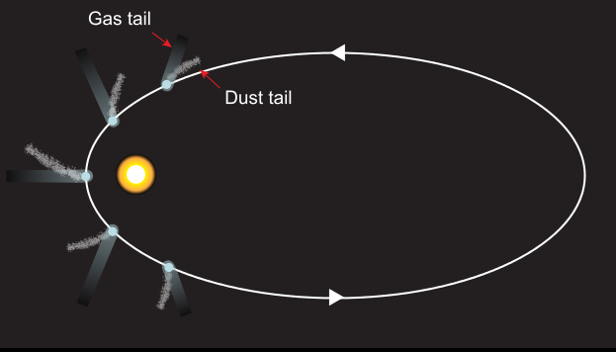
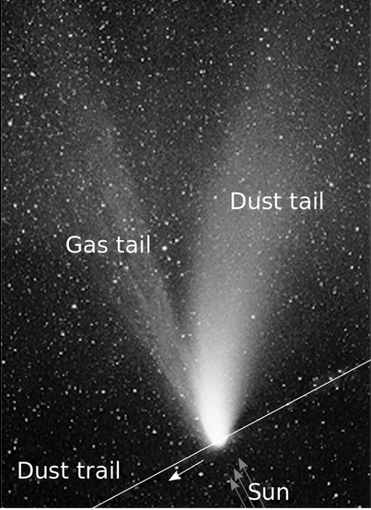
Comet tails: dust and gas

Slide 14
Question:
The movie shows observations of Halley’s Comet’s nucleus by the Giotto spacecraft. Giotto didn’t hit the nucleus. Why did the photos stop?

Slide 15
Answer:
Near to a comet nucleus, when it is close to the Sun, is a hazardous environment for spacecraft, due to possible impacts from particles expelled by the comet

Slide 16
Question:
Comet orbits are not completely predictable, so we speak of “recovering” a periodic comet when it is first confirmed to return. What might cause this erratic behavior?

Slide 17
Answer:
Perturbations from planets as the comet nucleus passes nearby.
Jets of gas from interior through crust can also alter orbit.

Slide 18
Cometary dust:
Spreads out along orbit of comet, observed as
Gegenschein (reflection of sunlight back toward Earth)
Zodiacal light (close to Sun)
Meteor showers (see later)

Slide 20
Zodiacal light

Slide 21
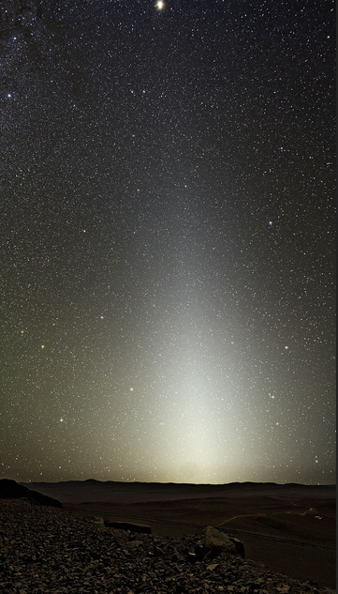
Zodiacal light at Paranal
Paranal is the site of the four 8-m telescopes run by the European Southern Observatory. It is located in the Atacama desert in Chile

Slide 22
Leonid meteor shower

Slide 23
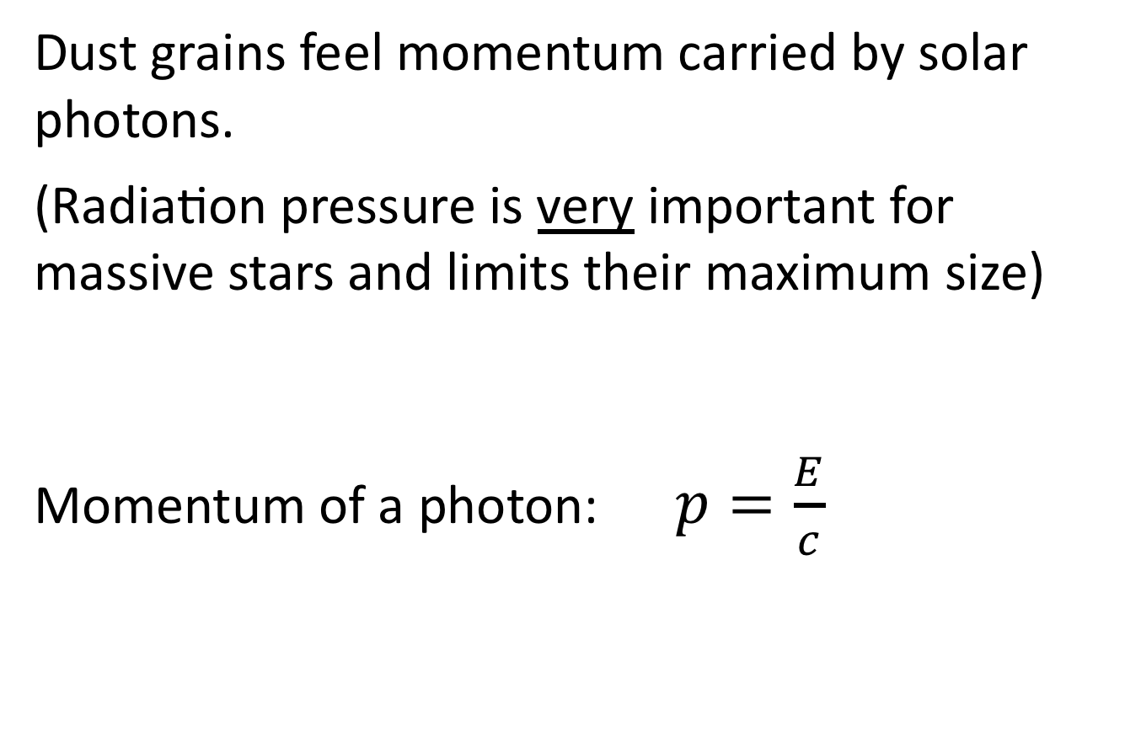
Radiation pressure
Dust grains feel momentum carried by solar photons.
(Radiation pressure is very important for massive stars and limits their maximum size)
Momentum of a photon: $p=\frac{E}{c}$

Slide 24

Calculate the radiation pressure at a distance r from the Sun:
Consider a shell of radius r. The force on the shell will be
$$F=\frac{dp}{dt}$$
Pressure$=\frac{force}{area}={\frac{dp}{dt}}/{4πr^{2}}$

Slide 25
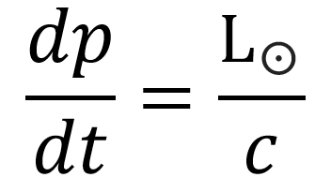

Using the equation for the momentum of a photon:
$$\frac{dp}{dt}=\frac{1}{c}\frac{dE}{dt}$$
Now $\frac{dE}{dt}$ is also the energy given off by the Sun every second, known as the solar luminosity L☉, so

Slide 26


So radiation pressure at radius r is

Slide 27
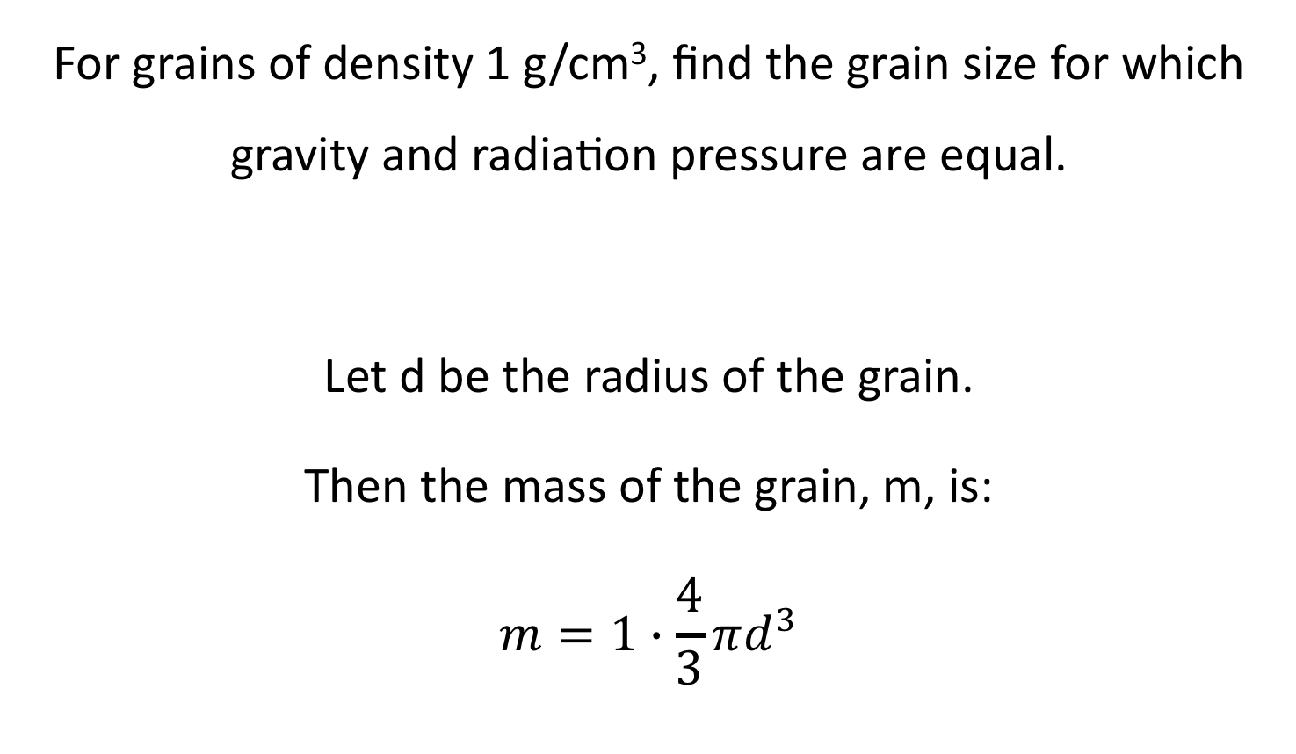
Example:
For grains of density 1 g/cm³, find the grain size for which gravity and radiation pressure are equal.
Let d be the radius of the grain.
Then the mass of the grain, m, is:
$$m=1∙\frac{4}{3}πd^{3}$$

Slide 28
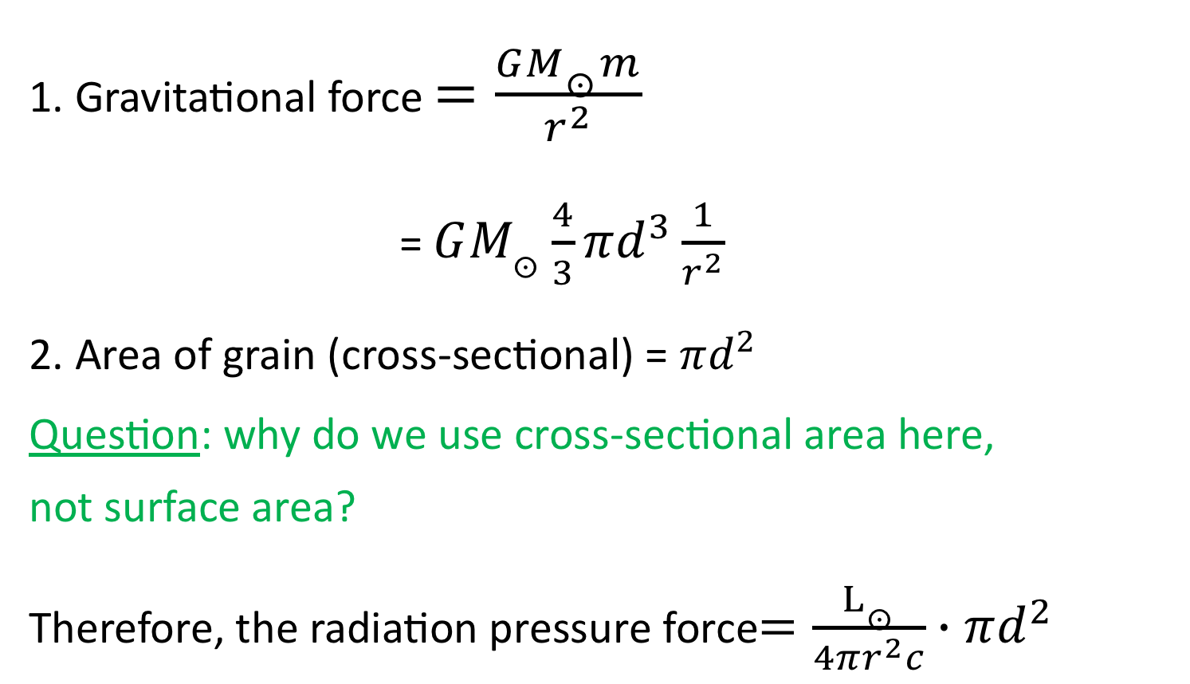
1. Gravitational force $=\frac{GM_{☉}m}{r^{2}}$
= $GM_{☉}\frac{4}{3}πd^{3}\frac{1}{r^{2}}$
2. Area of grain (cross-sectional) = $πd^{2}$
Question: why do we use cross-sectional area here,
not surface area?
Therefore, the radiation pressure force$=\frac{L_{☉}}{4πr^{2}c}∙πd^{2}$

Slide 29
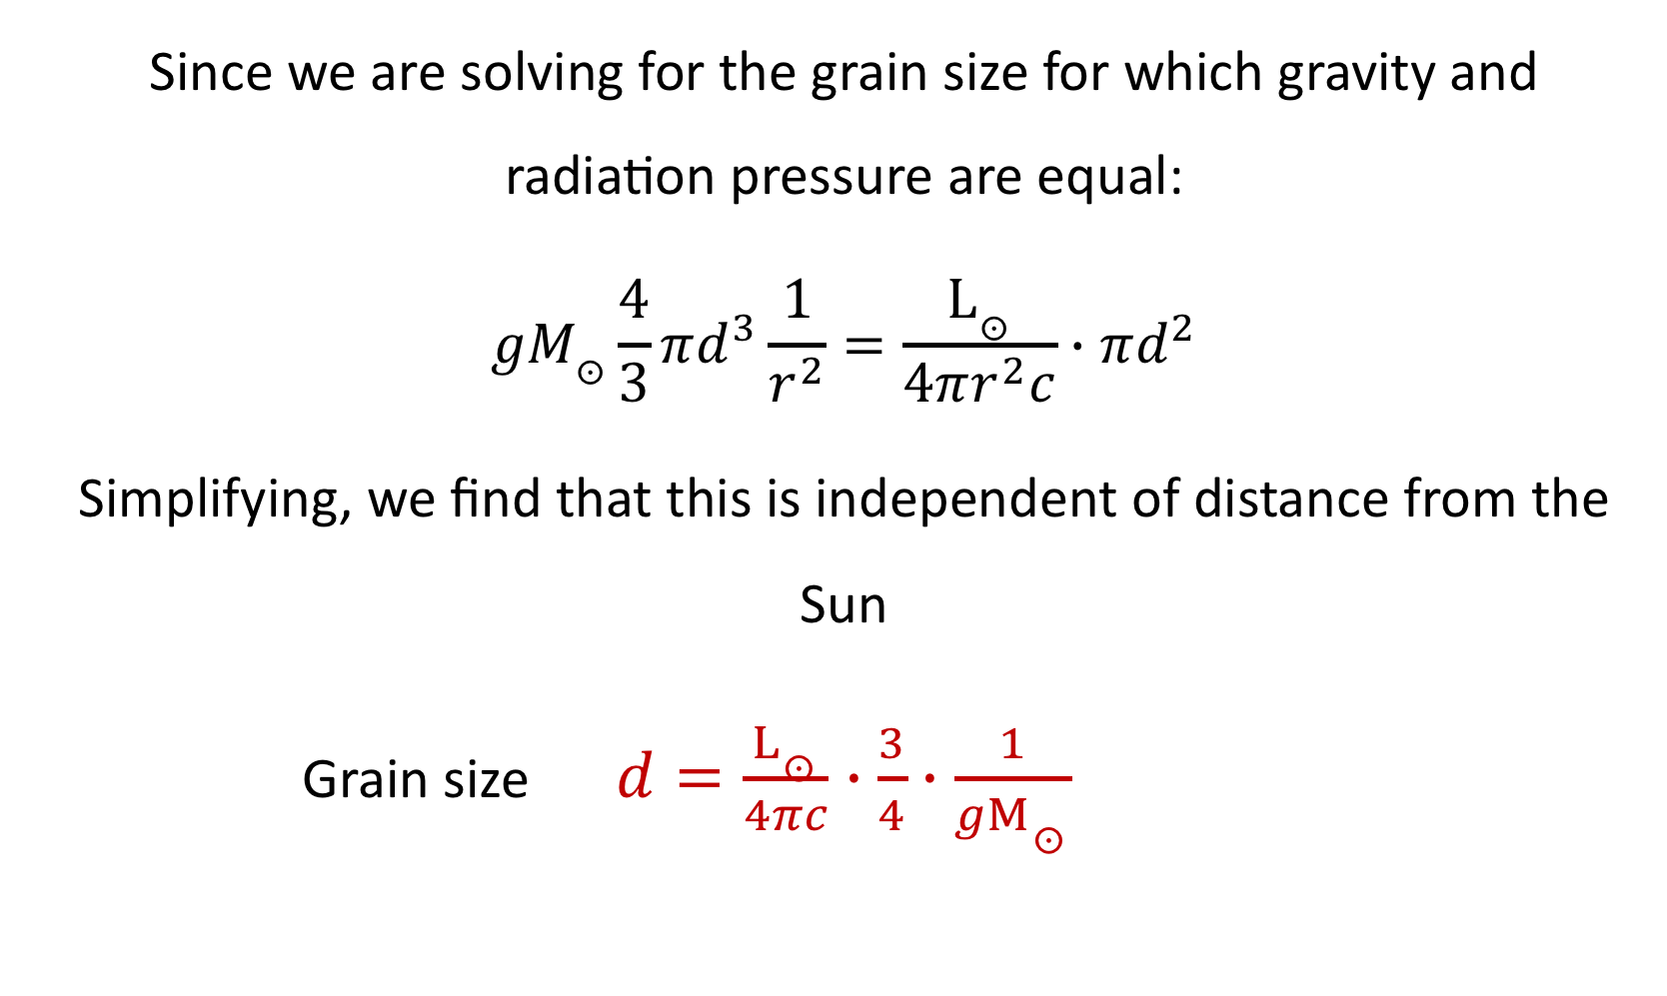
Since we are solving for the grain size for which gravity and radiation pressure are equal:
$$gM_{☉}\frac{4}{3}πd^{3}\frac{1}{r^{2}}=\frac{L_{☉}}{4πr^{2}c}∙πd^{2}$$
Simplifying, we find that this is independent of distance from the Sun
Grain size $d=\frac{L_{☉}}{4πc}∙\frac{3}{4}∙\frac{1}{gM_{☉}}$

Slide 30
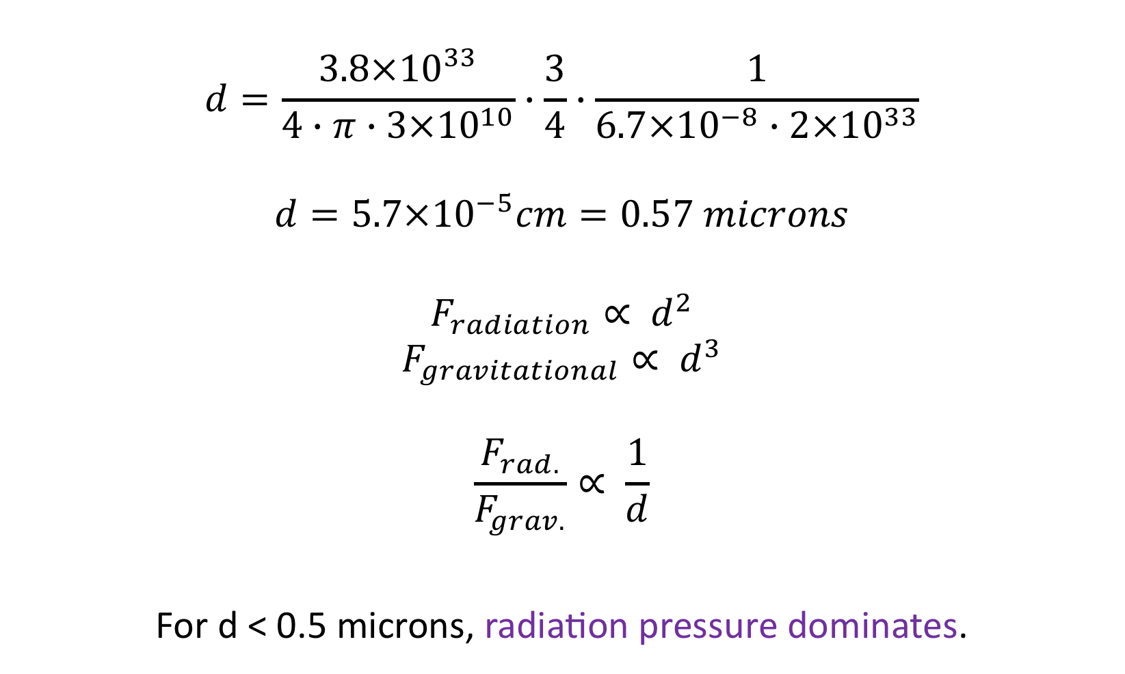
Calculation of actual grain size:
$$d=\frac{3.8×{10}^{33}}{4∙π∙3×{10}^{10}}∙\frac{3}{4}∙\frac{1}{6.7×{10}^{−8}∙2×{10}^{33}}$$
$$d=5.7×{10}^{−5}cm=0.57 microns$$
$$F_{radiation}∝ d^{2}$$
$$F_{gravitational}∝ d^{3}$$
$$\frac{F_{rad.}}{F_{grav.}}∝ \frac{1}{d}$$
For d ˂ 0.5 microns, radiation pressure dominates.

Slide 31
Origin (& home) of comets:
Most short-period comets:
have P=5-20 years
Have low inclination orbits
Orbit in prograde direction
Long-period comets:
Orbits are highly eccentric ellipses
appear nearly parabolic close to planets, but are bound to the solar system
inclinations of all sizes
(Note that Pluto is at ~40 AU; the
  nearest star is 2.7×10⁵ AU away
Historically, comets have been divided into short-period
(˂ about 200 years )
and long-period comets
(˃ 200 years approximately)

Slide 32
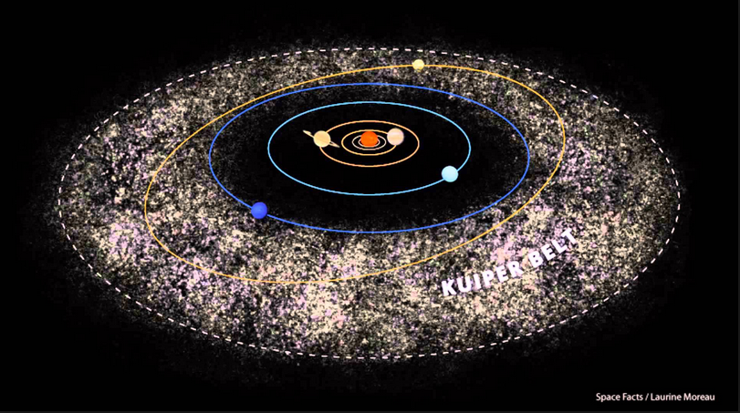
Kuiper belt

Slide 33
Kuiper Belt:
Home of short-period comets
Kuiper (‘51) suggested that a flattened ring of cometary nuclei outside of Neptune’s orbit were leftovers from the original solar system; where it petered out.
1992: The first Kuiper belt objects that were detected were the largest
  100-200 km
  magnitude 24-25 (night sky ̴ 20 mag/sq arcsec)
There are now many objects known with orbits that place them in the Kuiper belt

Slide 34
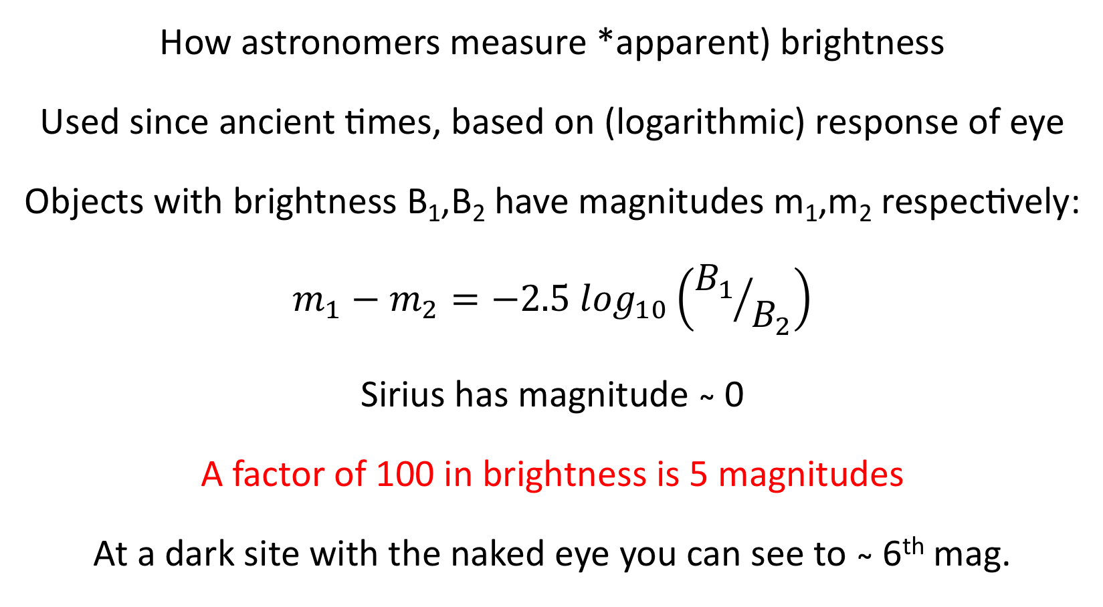
Magnitudes:
How astronomers measure *apparent) brightness
Used since ancient times, based on (logarithmic) response of eye
Objects with brightness B₁,B₂ have magnitudes m₁,m₂ respectively:
$$m_{1}−m_{2}=−2.5\log_{10}\left({B_{1}}/{B_{2}}\right)$$
Sirius has magnitude ̴ 0
A factor of 100 in brightness is 5 magnitudes
At a dark site with the naked eye you can see to ̴ 6th mag.

Slide 35
Kuiper Belt:
HST observations have shown the existence of objects the size of a typical comet nucleus ( ̴ 10 km) in the Kuiper belt
Mass of the Kuiper belt is very small:
  the current estimate is less than the mass of Earth
Pluto is a dwarf planet in the Kuiper belt
  eccentric orbit with e=0.25
  inclination to ecliptic 17°
Comets lose material on each successive perihelion passage
  …….we need a source of new comets as well

Slide 36
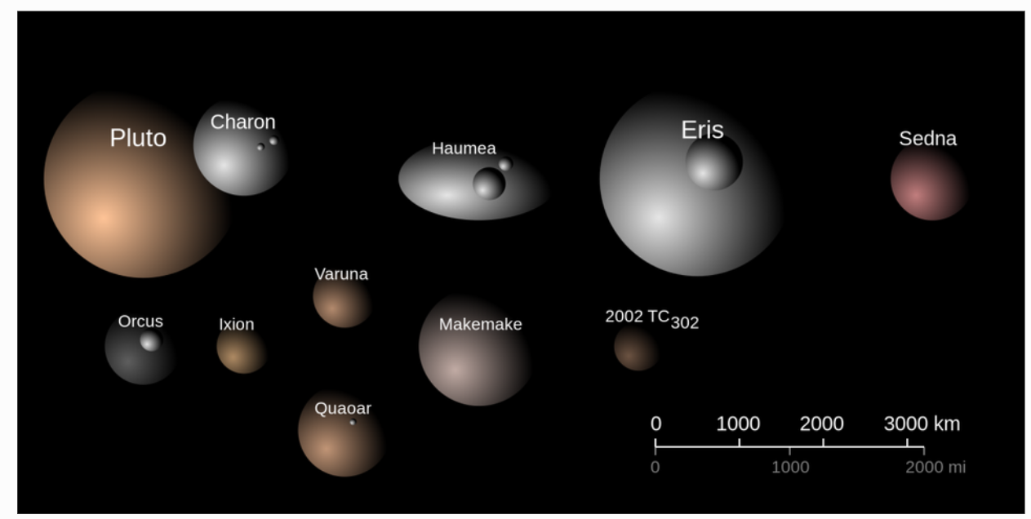
Illustration of relative sizes, colours and albedos of the large trans-Neptunian objects.

Slide 37
Another large Kuiper belt object: UB 313

Slide 38
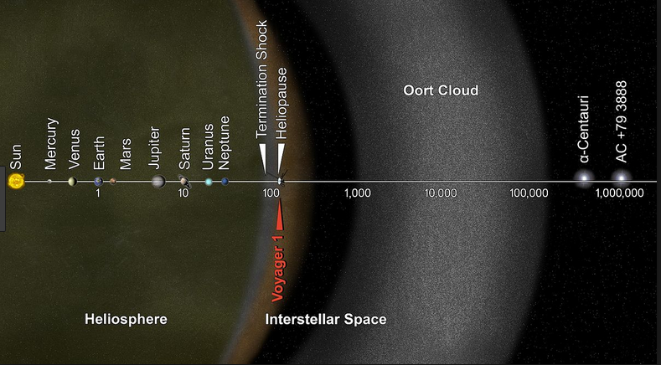
Oort Cloud:
Home of long-period (“new”) comets; Spherical shell at ̴10⁴-10⁵ AU
Comet nuclei spend billions of years there on average

Slide 39
Why cant we observe things in Oort cloud?
Evidence for Oort Cloud’s existence comes from comet orbits ONLY, no comet nuclei directly observed out there
Total Oort cloud mass is tiny: estimated as ̴ 10-100 Earth masses
Pluto orbits at ̴ 40AU and is so faint it was not discovered until 1930 (14th magnitude). If something like Pluto was located in the Oort cloud at 10,000 AU from the Sun, how much fainter would it appear from Earth?

Slide 40
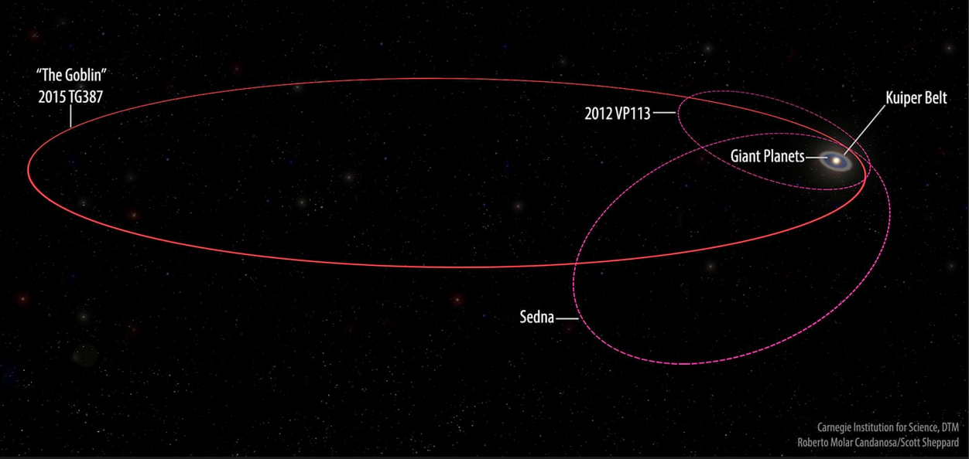
Orbital perturbations can send a comet into the inner
Solar System. Perturbations can come
From a passing star
From the Galaxy’s tidal field
From giant molecular clouds
The Goblin: Oort cloud object after it was kicked into the Solar System proper

Slide 41
Creation of Oort cloud via giant planet interactions

Slide 42
Kuiper belt comet nuclei thought to be leftovers from edge of early solar system
Chemical differences between long-period and short-period comets suggest short-period comets formed further from the Sun!
Oort cloud comets were probably originally formed near Jupiter and the asteroid belt and were then perturbed out by giant planets

Slide 43
Simulations of the formation of the Oort cloud
Dones et al 2004

