Slide 1
Collisions in the solar system
Collisions have played a major part in both the formation and the evolution of the solar system
Q: Can you give a number of pieces of evidence for collisions and impacts
In the early solar system?
Ongoing impacts?

Slide 2
Collisions early in solar system history
The differing tilt of planetary rotation axes is best explained by a period of giant collisions

Slide 3
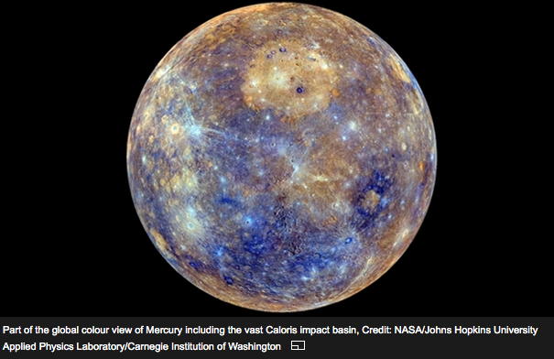
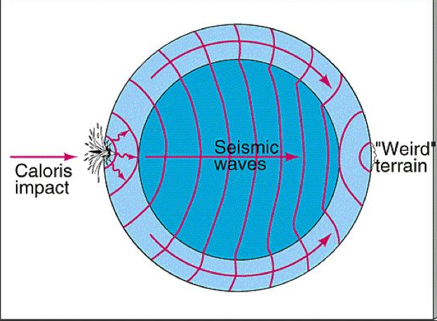
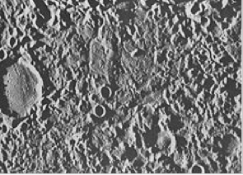
Evidence for early collisions:
Craters and other features on Moon and Mercury (no tectonics to resurface)

Slide 4
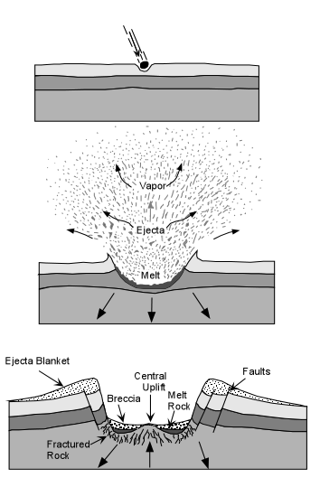
Crater formation
Shock reflection can form peak in center of crater
Rocks can be crushed (breccia) or even melted if impact is energetic enough

Slide 5
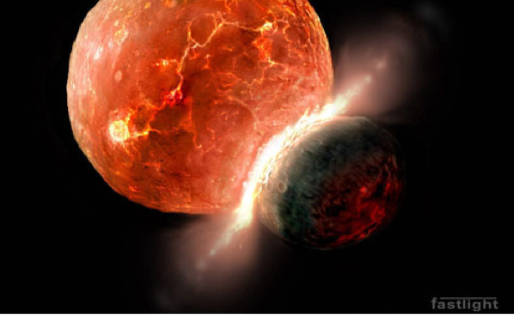
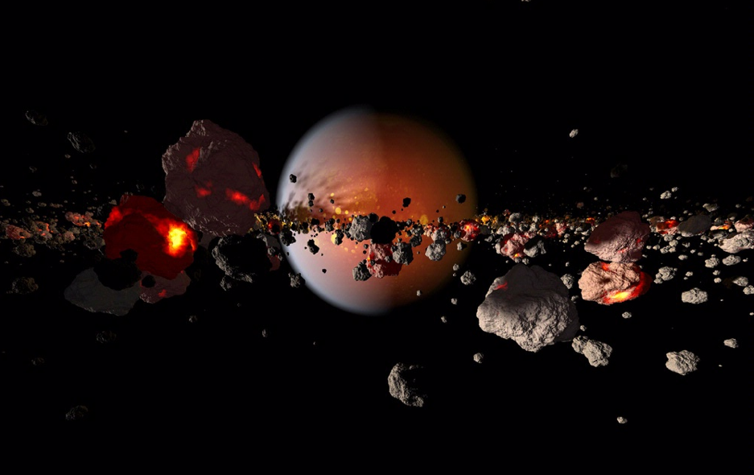
The Moon’s composition
Apollo astronauts brought back samples of Moon rocks. They are *very* similar to rocks found on the surface of the Earth
Current theory is that the Moon was formed from debris left from a giant collision between a Mars-sized object and the Earth

Slide 6
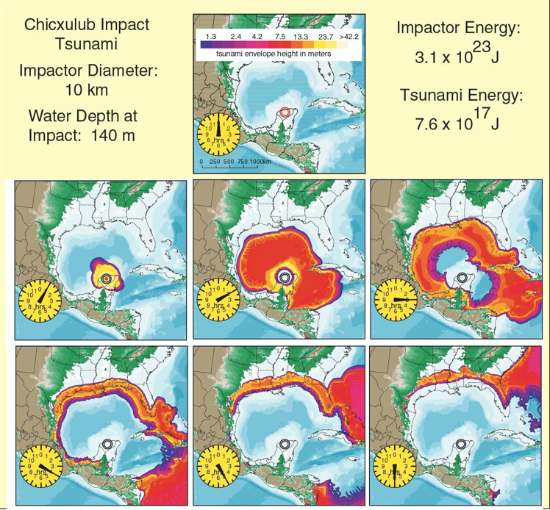
Steven Ward UCSC

Slide 7
Yellow circles show estimated peak height in meters

Slide 9
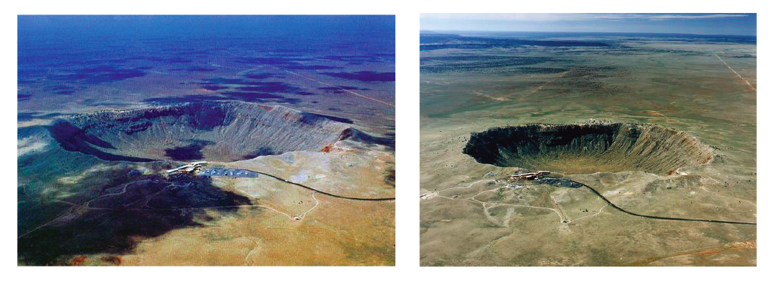
Ongoing collisions:
Arizona meteor crater: 1 km wide, 50,000 years old

Slide 11
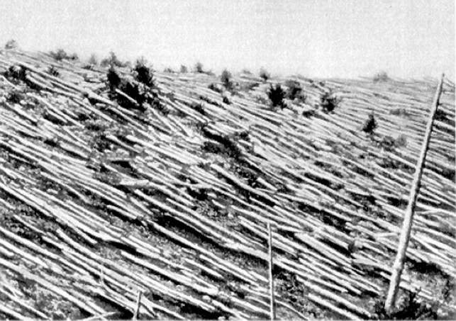
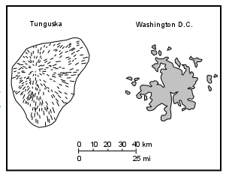
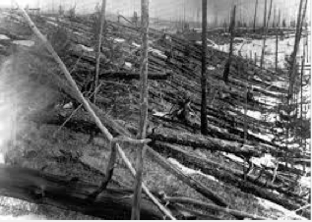
More recent collisions:
Tunguska, Siberia, 1908: (no crater) large cometary fragment thought to have exploded in atmosphere just above Earth’s surface

Slide 12
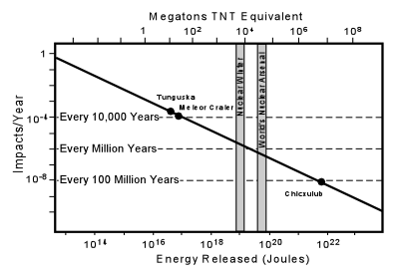
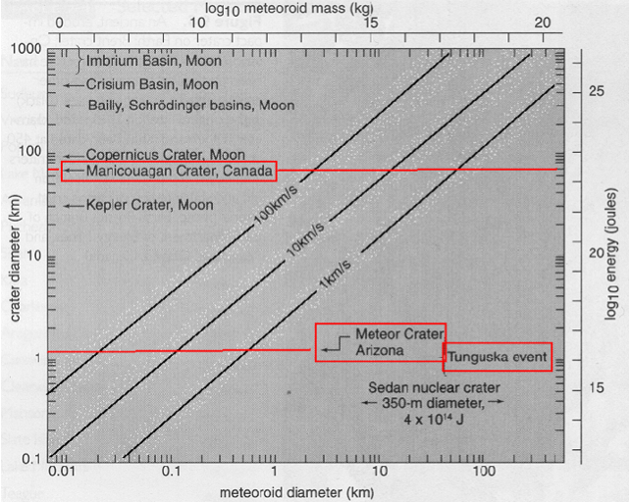
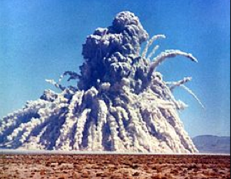
Energy released in impacts
Sedan nuclear test (shallow underground test in Nevada 1962)

